Slide 1
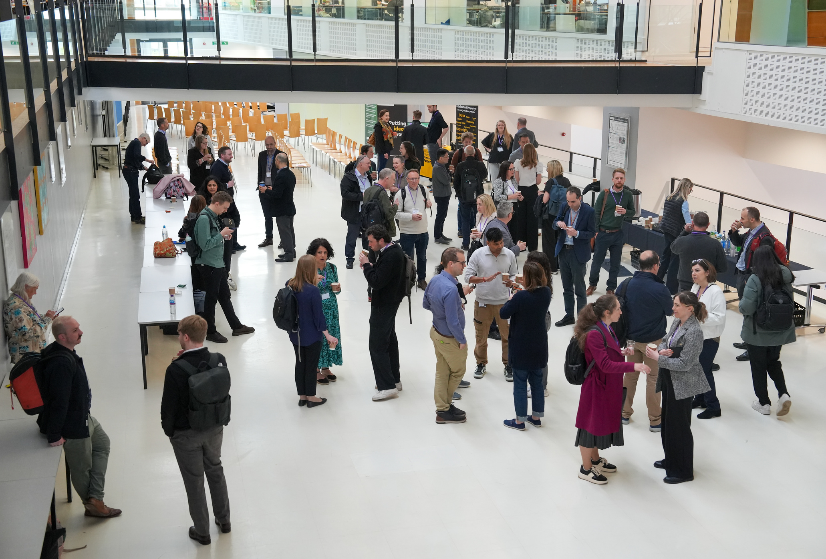
Equity, Partnership and Participation in Applied Research
CADDA, Diagnostics and the drive towards health equity
Dr Paul Meakin, Project Director, CADDA

Slide 2
Diagnostics as a tool in health equity and inclusivity

Slide 3
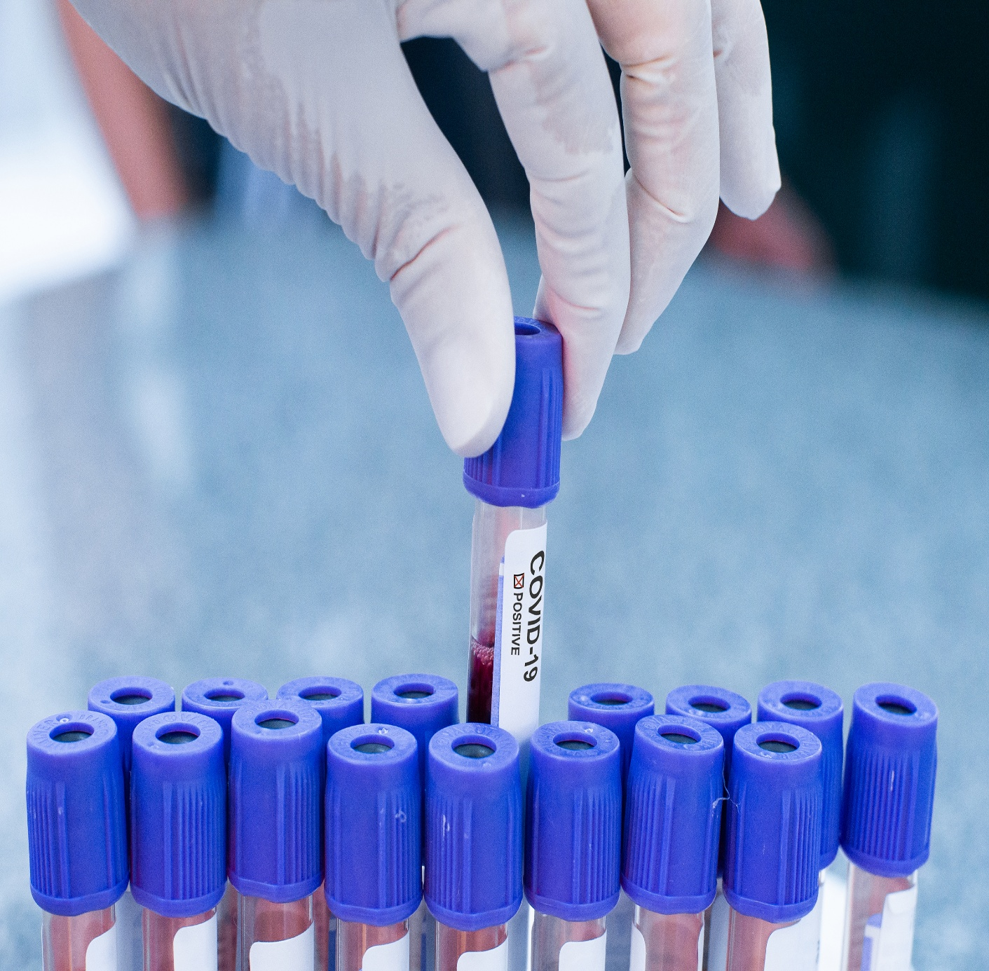
What is CADDA?
Centre for Advanced Diagnostic Development and Application.
Four-year, £8 million initiative funded by Research England and the participating universities
Led by the University of Kent, in conjunction with University of Manchester and University College London
Ambition is to stimulate and support academic-industry collaborations to benefit the UK diagnostics sector

Slide 4

Our activities
Awarding small research grants to academic-industry partnerships to support the journey of diagnostic development and application
Creating opportunities for collaborations to begin and grow
Sign-posting innovators to other resources
Delivering industry-focused support for diagnostic businesses via Kent Business School

Slide 5
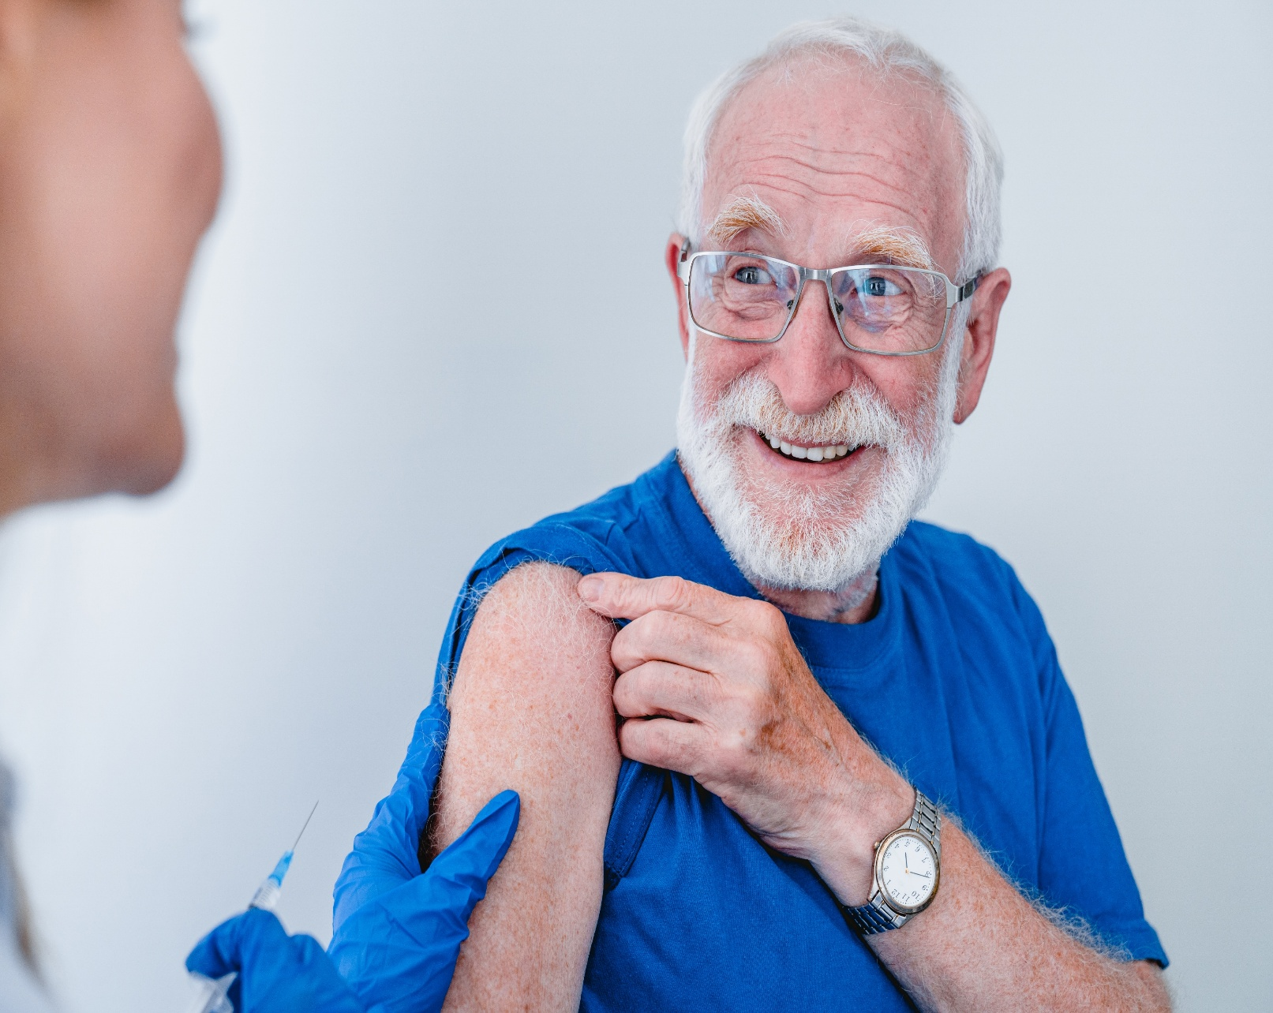
Diagnostics supporting health equity and inclusivity
Point of care testing – in clinics, pharmacies and community hubs
Home based testing – self sampling for many conditions
Culturally appropriate screening – diabetes among high-risk populations
Design for inclusivity – languages, packaging, audio guidance, clarity of display

Slide 6
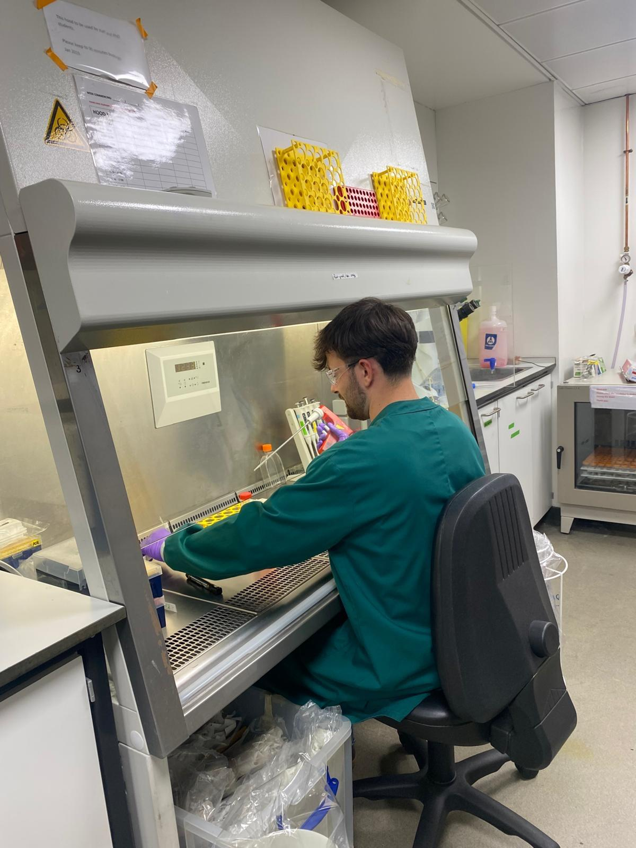
CADDA projects supporting health equity and inclusivity
Malaria rapid test
Cervical HPV sampling device
Mobile MRI for dementia screening
Continuous monitoring of hormones

Slide 7
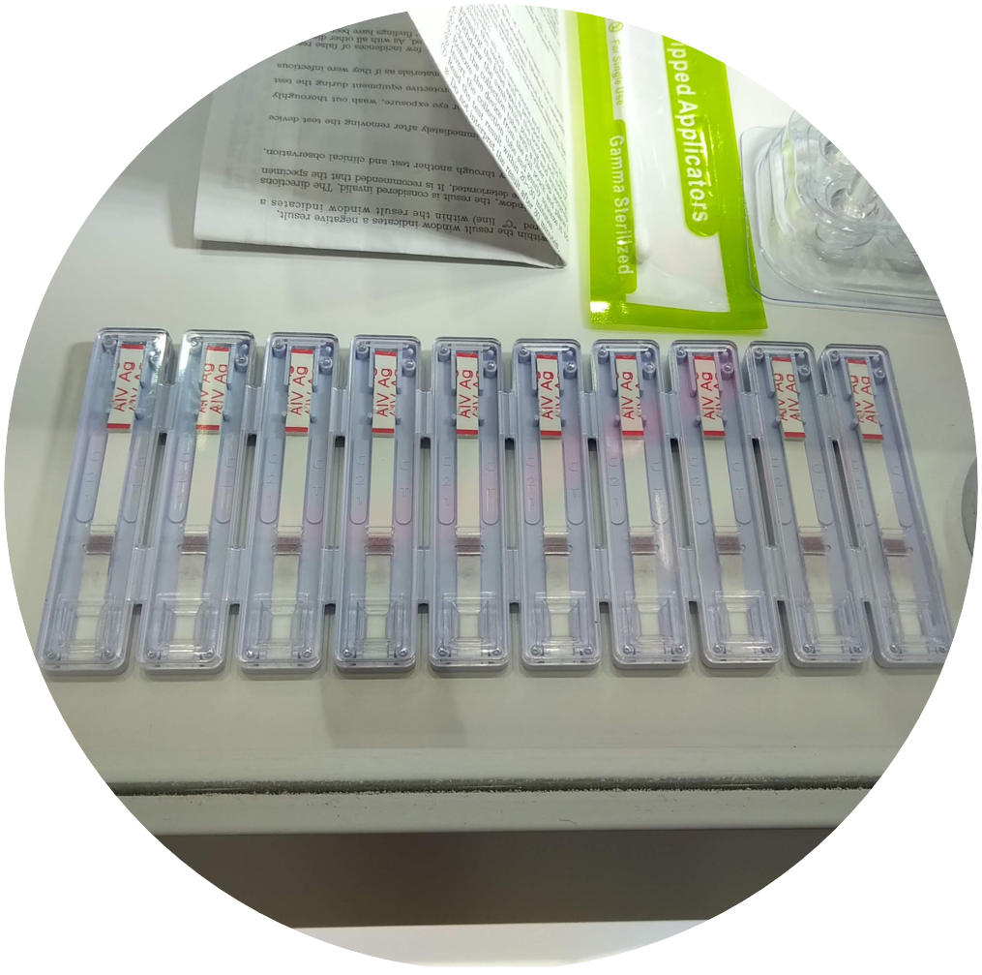


CADDA project example #1
Rapid test to detect Plasmodium parasites
Project uses electrokinetic forces created by a salt gradient to enhance sensitivity of a lateral flow test for malaria
Huge demand for low cost, sensitive assays for malaria in affected parts of the world
Low cost testing in local settings is essential for screening remote communities, allowing timely treatment

Slide 8


CADDA project example #2
Cervical HPV sampling device
Improving uptake of HPV primary cervical screening using a clinically-validated, self-sampling diagnostic tampon
Low participation in screening programmes among women in deprived communities
Project will generate quantitative and qualitative evidence base needed to optimise implementation, improve uptake, and reduce inequalities

Slide 9
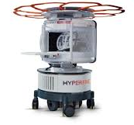
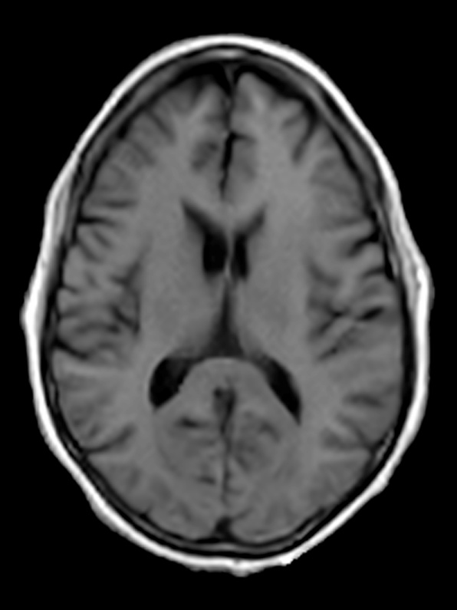
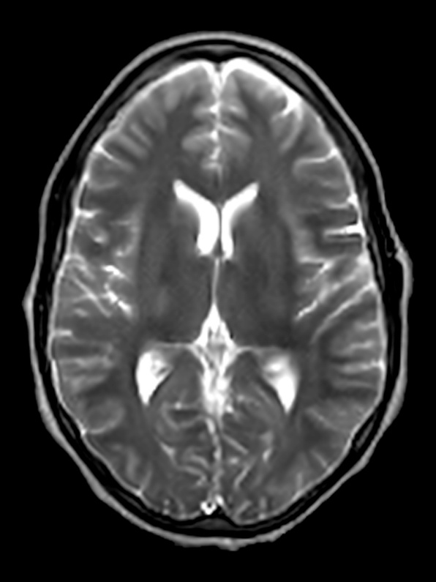


CADDA project example #3
Mobile MRI for dementia screening
Reducing inequalities in dementia care
Combining cognitive testing, blood biomarkers and low field MRI scans for diagnosis of dementia
Aim to have MRI scanner in van to take scanning into the community

Slide 10

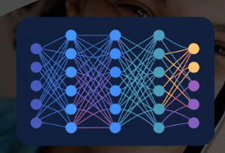


CADDA project example #4
Continuous monitoring of hormones
Continuous monitoring of hormones in the blood stream – so important for management of multiple conditions
Innovative wearable device collecting regular data over time on hormone concentrations. Potential for use with other biomarkers.
Building data set for the individual and correlating with symptoms and well-being

Slide 11
How can CADDA assist your diagnostics journey?
Grant funding
Sign-posting to other sources of information and support
Meetings, events, workshops on topics relevant to the diagnostics sector

Slide 12
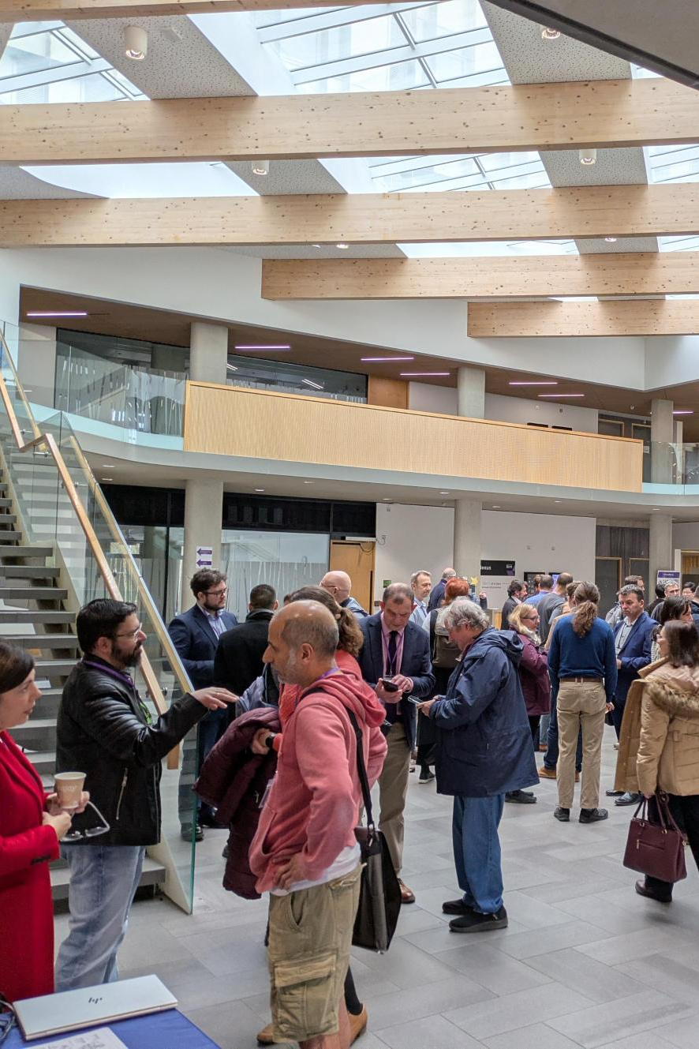
How can CADDA support your diagnostic journey?
Grant funding: Up to £50,000 for industry/academic collaborative projects.
Academic leads from 3 partner universities, with an industry partner. Co-applicants from HE institutions, NHS and other organisations welcomed.
Next funding call 15 September 2026, closes 2 November 2026. All information and forms on our website: https://www.cadda.org/funding/

Slide 13
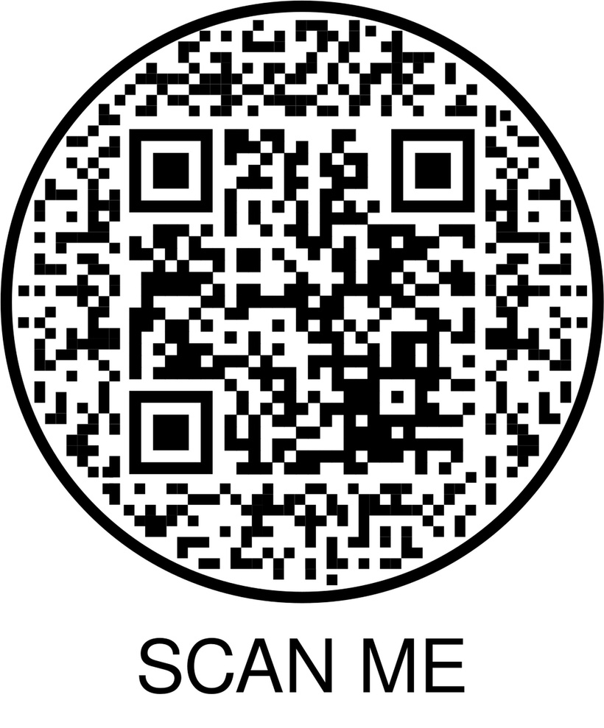

Scan the QR to join the
Centre for Advanced Diagnostics Development and Application (CADDA)
Community of Practice
Or visit www.cadda.org/join-us
Follow us on LinkedIn @Centre for Advanced Diagnostics Development and Application
Email: cadda@kent.ac.uk

Slide 14
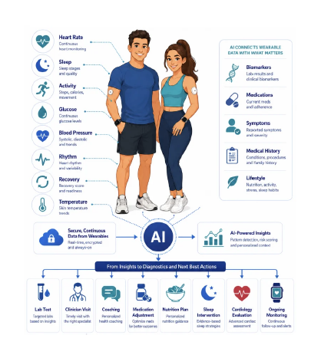


Slide 15
Thank you, please come and talk with the CADDA team

