Slide 1



NIHR ARC KSS
Knowledge Mobilisation (KM)
Research Week 2026
Dr Julie Macinnes, ARC KSS Academy
Lucie Hooper, HIN KSS
Beth Flowers, ARC KSS Academy

Slide 2
What is Knowledge Mobilisation?
Knowledge mobilisation is NOT research (although it uses some of the same skills and methods)
It is about getting the right information (including research and other sources of evidence), at the right time, to the right people, in the right way, to achieve better outcomes for patients
It has similarities with quality improvement (QI) but aims to produce more generalisable outputs (outside the local context) and explores the processes of implementation in more detail
Notes:
The programme is about 1) the development of your knowledge and skills in KM 2) Impact of the KM project 3) capturing the learning about how to mobilise knowledge in health and social care for scale and spread of your project and other KM project
There will be 8 KM Fellows across KSS

Slide 3
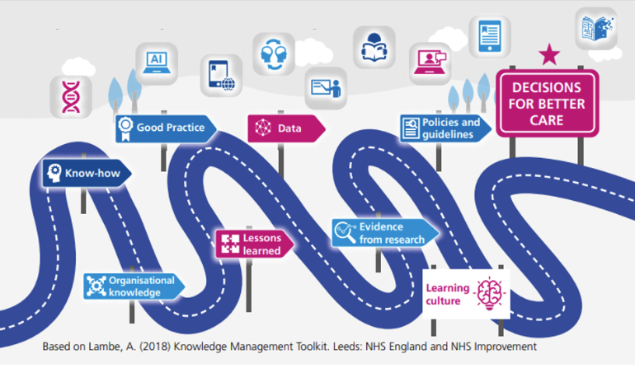
The Pathway to Informing Better Decisions for Care

Slide 4
How to mobilise knowledge?
It involves:
Identifying the knowledge/evidence to be ‘mobilised’ and identifying the knowledge-practice gap
Adapting that knowledge to local contexts and organisations
Implementing knowledge and identifying the barriers and facilitators to implementation
Measuring what is being achieved (outcomes) and how (process)
Ensuring knowledge is still being used in the medium and long-term (sustainability)
Engagement with staff and teams is the hallmark of good knowledge mobilisation

Slide 5
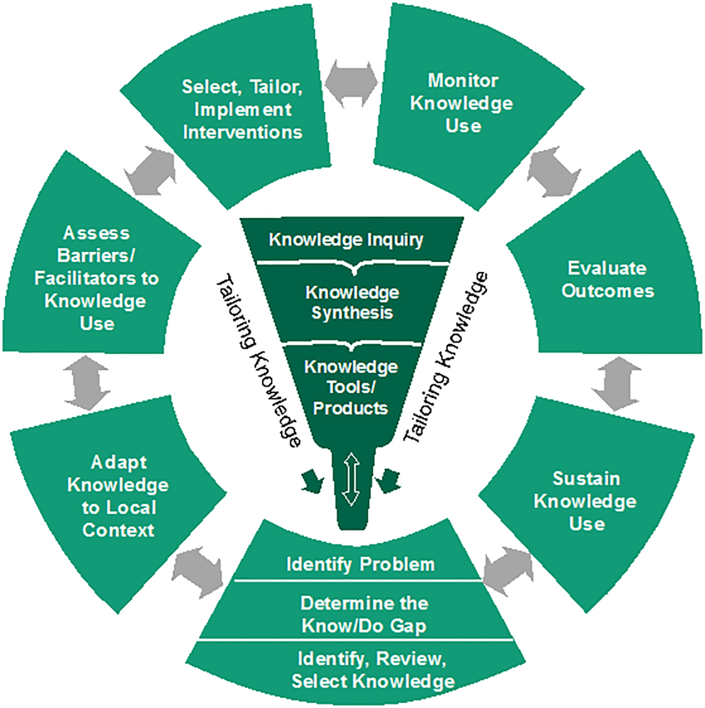
Introducing the Knowledge to Action (K2A) Framework (Graham, 2006)
Notes:
No linear

Slide 6
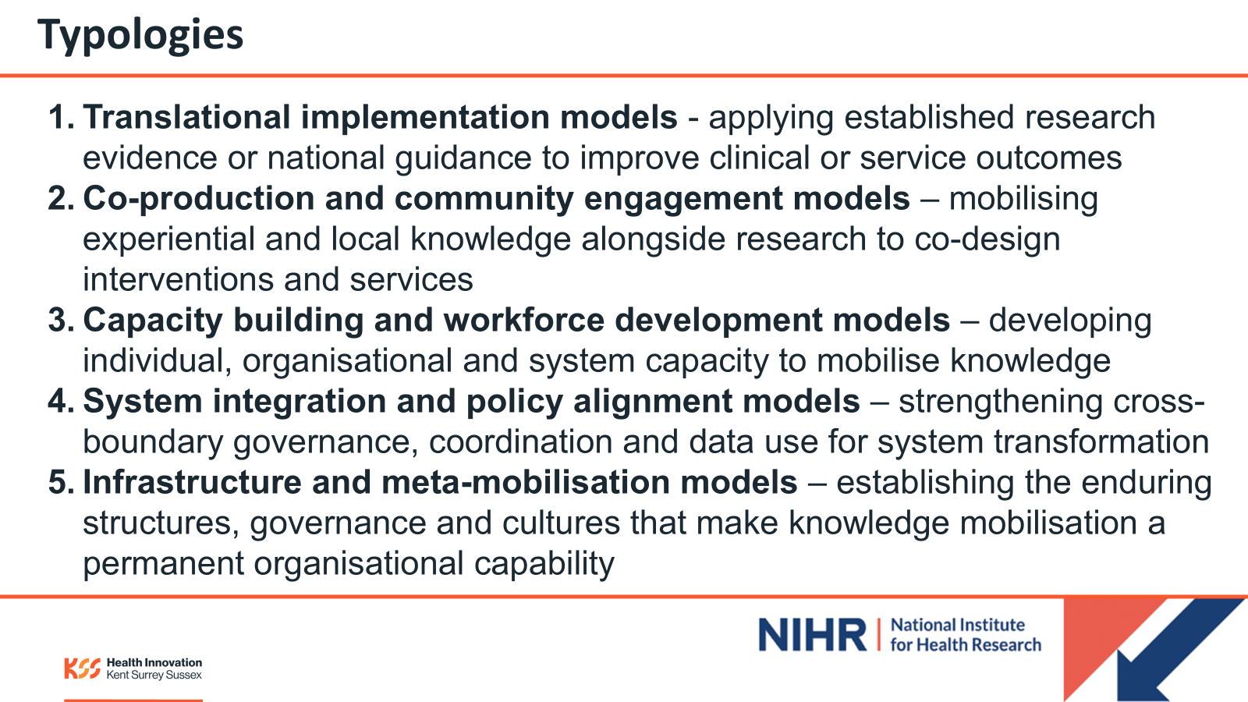
Notes:
No linear

Slide 7
Engaging Stakeholders – Who?
“An iterative process of actively soliciting the knowledge, experience, judgment and values of individuals selected to represent a broad range of direct interests in a particular issue” (Boaz, 2018)
Who?
Patients and the public (PPI)
Providers (health and social care; voluntary, community and social enterprise (VCSE) organisations)
Purchasers (service commissioners),
Payers (e.g insurance companies)
Policy-makers
Product makers (e.g technology companies)
Principal investigators (other KM, QI or researchers)

Slide 8
Engaging Stakeholders – How?
Preparing for the project – e.g selecting evidence, identifying the knowledge-practice gap
Conducting the project – e.g Defining the aim/purpose of the project, designing the project, choosing and prioritising relevant outcomes; developing and/or revising project materials, interpreting findings; monitoring process (governance)
Using the outputs of the project – e.g disseminating results, including scale and spread
Mechanisms – e.g stakeholders as named collaborators; webinars and/or consensus building workshops; advisory/steering groups.

Slide 9
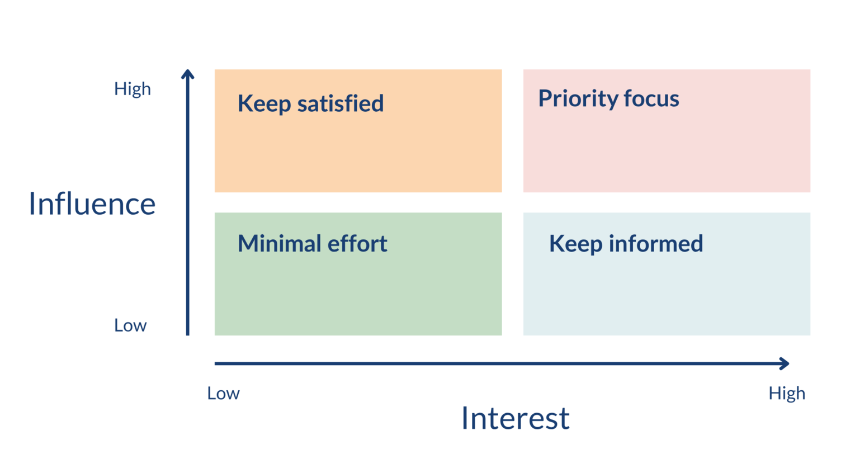
Stakeholder Engagement - levels

Slide 10
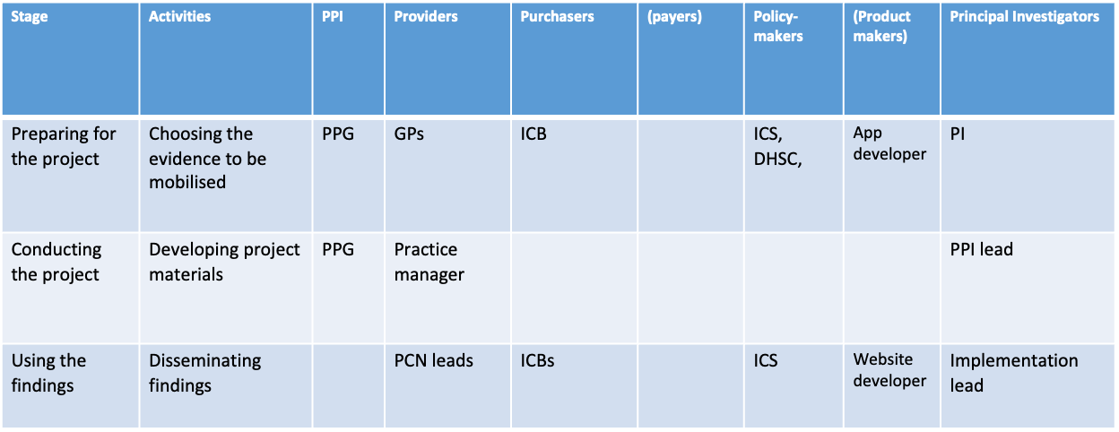
Stakeholder Mapping

Slide 11
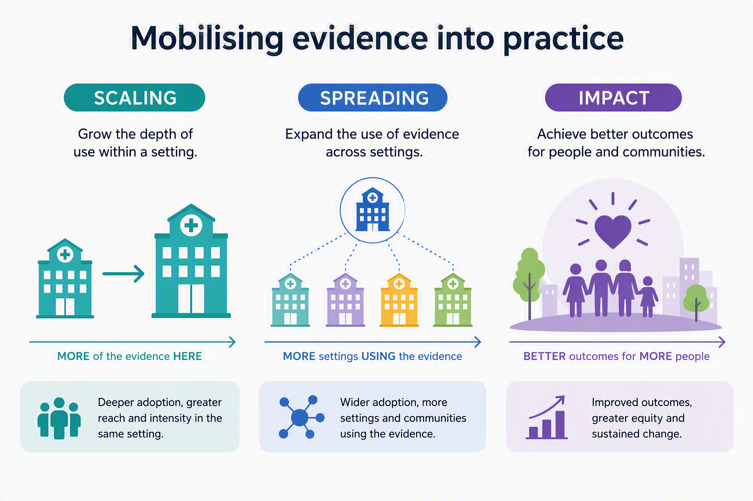
Scaling, spreading and impact

Slide 12
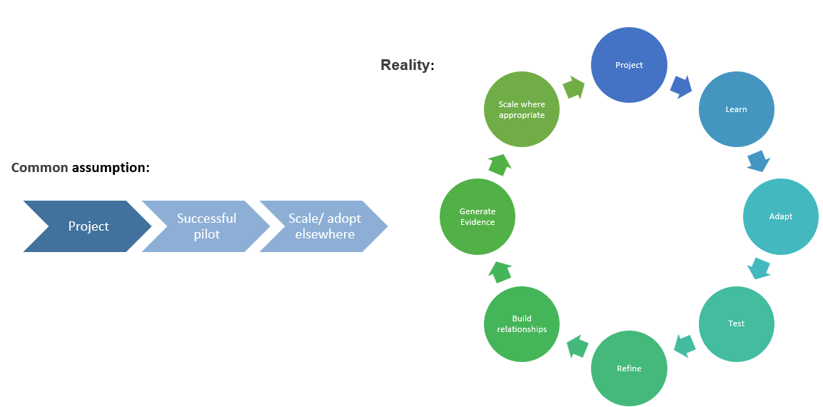
Spreading isn’t about lifting and shifting

Slide 13
What does success look like?
Not all projects will/ need to become adopted nationally
Instead, success could look like:
influencing one neighbouring organisation
changing local policy
informing NICE guidance
Adoption of a resource in practice
contributing evidence to a wider programme
changing professional practice
informing future research

Slide 14
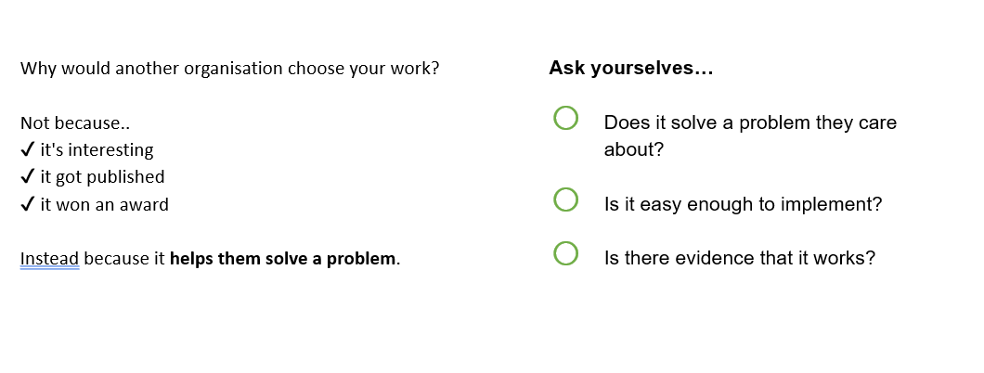
People don't adopt evidence - they adopt solutions

Slide 15
What helps a solution spread?
Clear problem
Simple solution
Strong evidence
Adaptable
Clinical champions/ leadership
Leadership support
Fits existing workflows

Slide 16
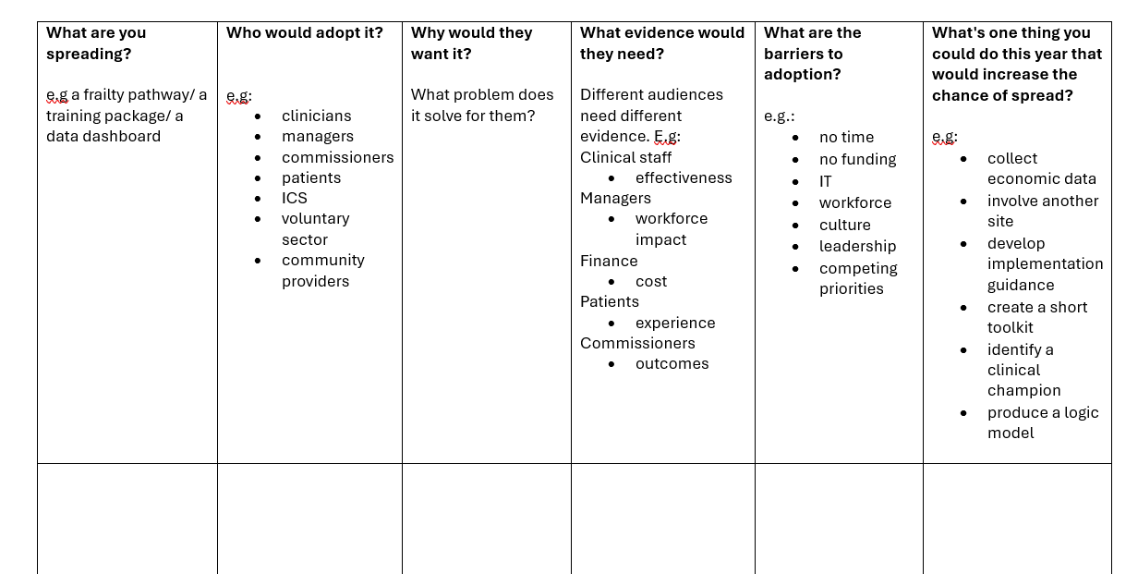
Scale Canvas

Slide 17
Selected Reading
Graham ID, Logan J, Harrison MB, Straus SE, Tetroe J, Caswell W, Robinson N. Lost in knowledge translation: time for a map? J Contin Educ Health Prof. 2006 Winter;26(1):13-24. doi: 10.1002/chp.47: https://pubmed.ncbi.nlm.nih.gov/16557505Links to an external site.
Field, B., Booth, A., Ilott, I. et al. Using the Knowledge to Action Framework in practice: a citation analysis and systematic review. Implementation Sci 9, 172 (2014). https://doi.org/10.1186/s13012-014-0172-2Links to an external site.
Boaz, A., Hanney, S., Borst, R., O’Shea, A., and Kok , M. (2018) How to engage stakeholders in research: design principles to support improvement. Health Research Policy and Systems.16:60 https://doi.org/10.1186/s12961-018-0337-6
Concannon, T.W., Grant, S., Welch, V. et al (2018) Practical Guidance for Involving Stakeholders in Health Research. J Gen Intern Med 34(3):458–63 https://www.researchgate.net/publication/329766735_Practical_Guidance_for_Involving_Stakeholders_in_Health_Research

