Slide 1

Building Research Capacity:
ARC KSS Research week 2026
Advancing Inclusive Research
Equity, partnership, and participation in applied research

Slide 2
NIHR Applied Research Collaborations (ARCS)
NIHR Applied Research Collaborations (ARCs) support applied health and care research that responds to, and meets, the needs of local populations and local health and care systems
There are 10 ARCs (currently) which are collaborations between NHS providers, Universities, Charities, Local Authorities, Health Innovation Networks and other organisations who undertake research and implementation to increase the rate at which research findings are translated into practice
The ARCs aim to:
Improve outcomes for patients and the public
Improve the quality, delivery and efficiency of health and care services
Increase the sustainability of the health and care system both locally and nationally

Slide 3
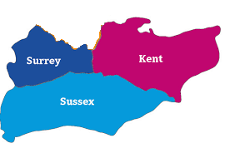
NIHR Applied Research Collaboration Kent, Surrey and Sussex
(ARC KSS)
ARCKSSacademy@kent.ac.uk
https://arc-kss.nihr.ac.uk/

Slide 4
Data insights for health inequalities
Health in places
Research themes
Conducting research to tackle the biggest health and care challenges
Knowledge Mobilisation
Responsive application of knowledge to improve health, wellbeing and care
Early years and parenting
Mental health
Primary and community healthcare
Collaboration and partnerships
Collaborating with partners in and out of region
Research
Capacity Building
A research culture embedding research in practice and the workforce
Public and
community need
Research that meets regional and national public and community needs

Slide 5
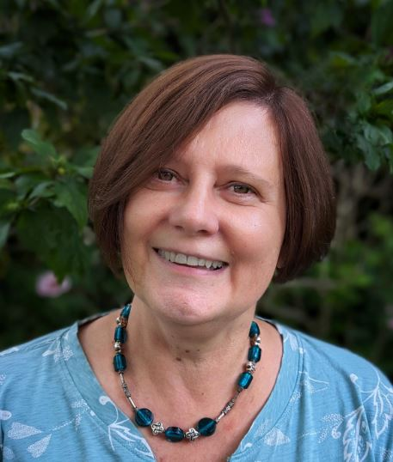
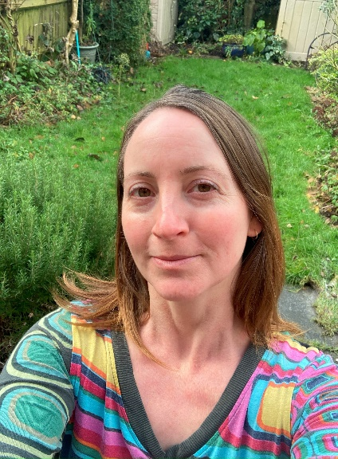
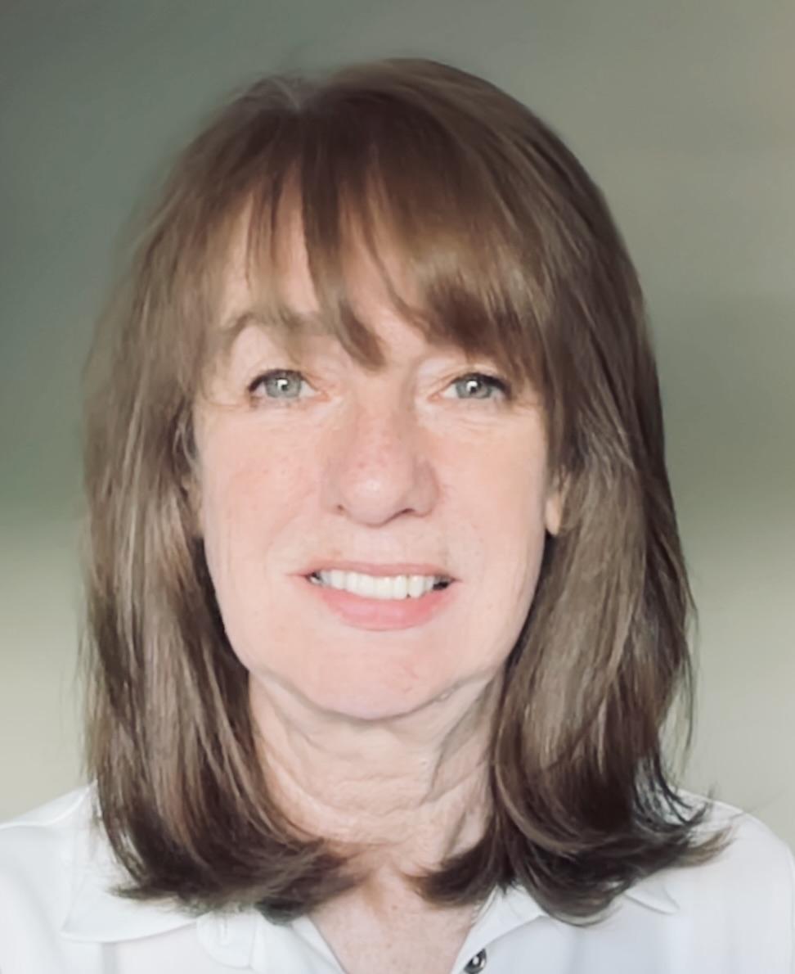
Meet the ARC KSS Academy Team
Dr Julie MacInnes
Beth Flowers
Theresa Gadsby-Bourner
Research Capacity and Academic Career Development Lead
Academy Manager
Academy Facilitator

Slide 6
Research week 14th - 17th Sept 2026
online sessions and 17th in-person at University of Kent:
Advancing Inclusive Research
An In Person Symposium on Equity, Partnership and Participation in Applied Research
From Monday 14 September to Wednesday 16 September, we will host a series of online events exploring inclusive, collaborative and impactful approaches to applied health and social care research.

Slide 7
Monday 14 Sept 2026
On line: Teams
10:30: From 'Hard to Reach' to ‘Seldom Heard’: Rethinking Research Engagement
Alison Lacey ,Michelle Lefevre, Jeri Damman
link https://www.eventbrite.co.uk/e/early-years-and-parenting-tickets-1994658282618?aff=oddtdtcreator
1:30: Accounting for Sex and Gender in Research – NIHR Policy
Prof Carrie Llewellyn
Link https://www.eventbrite.com/e/accounting-for-sex-and-gender-in-research-nihr-policy-tickets-1994659112099?aff=oddtdtcreator
3:00: Mental Health Innovation and Implementation Theme: James Lind Alliance Priority Setting
Dr Devyn Glass, Charlotte Edwards
Link: https://www.eventbrite.com/e/mental-health-innovation-and-implementation-tickets-1994659324735?aff=oddtdtcreator

Slide 8
Tuesday 15 Sept 2026
On Line - Teams
10:30: HCP Internships first year Celebration
Dr Julie MacInnes, Beth Flowers
Link: https://www.eventbrite.co.uk/e/nihr-hcp-internship-celebration-event-tickets-1991452970443?aff=oddtdtcreator
2:00: The Participatory Approach to Research – addressing barrier to research
Bernadette Egan
Link: https://www.eventbrite.com/e/the-participatory-approach-to-research-addressing-barrier-to-research-tickets-1994660234456?aff=oddtdtcreator
3:00: Working with routinely collected data: in-depth skills focus
Dr Mel Rees-Roberts, Dr Liz Ford
Link: https://www.eventbrite.com/e/working-with-routinely-collected-data-in-depth-skills-focus-tickets-1994660974670?aff=oddtdtcreator

Slide 9
Wednesday 16 Sept 2026
On Line: Teams
10:00: From Partnership to Impact: Lessons from the National Priority Programme for Adult Social Care and Social Work
Madalina Toma
https://www.eventbrite.co.uk/e/from-partnership-to-impact-lessons-from-the-national-priority-programme-tickets-1994001384819?aff=oddtdtcreator
11:30: Barriers to participatory research: A Case Study in Researching Trans Healthcare
Elle Whitcroft
Link: https://www.eventbrite.com/e/barriers-to-participatory-research-researching-trans-healthcare-tickets-1994661822205?aff=oddtdtcreator

Slide 10
Thursday 17th September
In person Symposium, Darwin, University of Kent
Keynote Speaker Prof Stephen Peckham
Health in places: Dr Sarah Hotham, Professor Lindsay Forbes,
Knowledge Mobilisation: Julie MacInnes, Beth Flowers, Lucie Hooper
How can CADDA support your journey? Diala Nikolaeva, Laura Simpson
Networking Lunch, ViPER presentations and poster competition
REN: Building partnerships with communities for inclusive research: Virginia Govoni, REN Sussex
Lily Keck
Research Poster Competition winners announced
https://www.eventbrite.co.uk/e/research-week-2026-advancing-inclusive-research-tickets-1991446245328?aff=oddtdtcreator

Slide 11
Thank you
ARCKSSacademy@kent.ac.uk
https://arc-kss.nihr.ac.uk

