Slide 1

ARC-KSS
Data Theme –
In Depth Skills Focus
Dr Elizabeth Ford
Associate Professor in Health Data Science
Brighton and Sussex Medical School

Slide 2
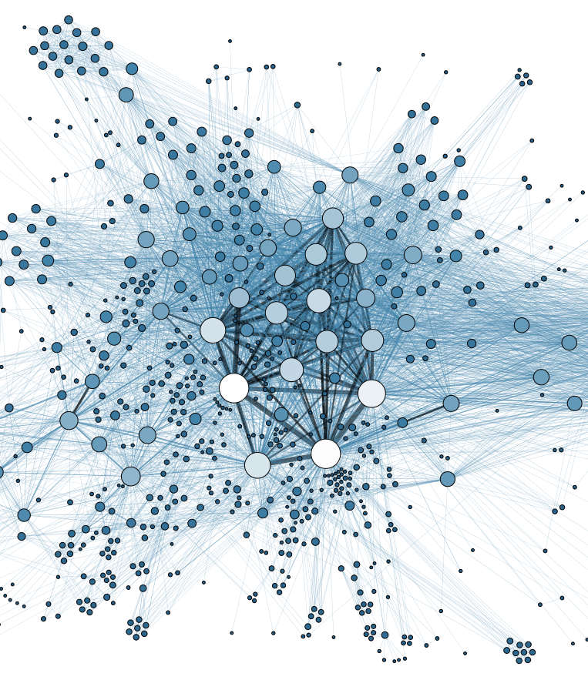
Today’s focus
What kind of data are we talking about and what does it look like? – Liz
What skills and preparation would I need to start a project with NHS data? – Imogen
A PhD student’s experience of tackling linked NHS data – Bria

Slide 3

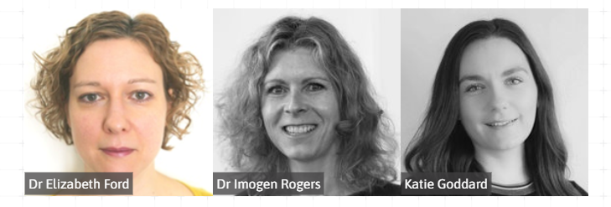
Data Theme team
Dr Mel Rees-Roberts

Slide 4
Data Driven Insights Theme: Objectives
Understand current system needs based on real-world data
Support the prevention of ill-health by identifying underserved or marginalised groups – studying sociodemographic, geographic and clinical factors
Develop methods to identify conditions earlier – risk stratification and prediction
Produce tools to target interventions - finding at-risk groups, working on implementation
Create and deliver training and support resources for new analysts via the ARC KSS Data Science Hub

Slide 5
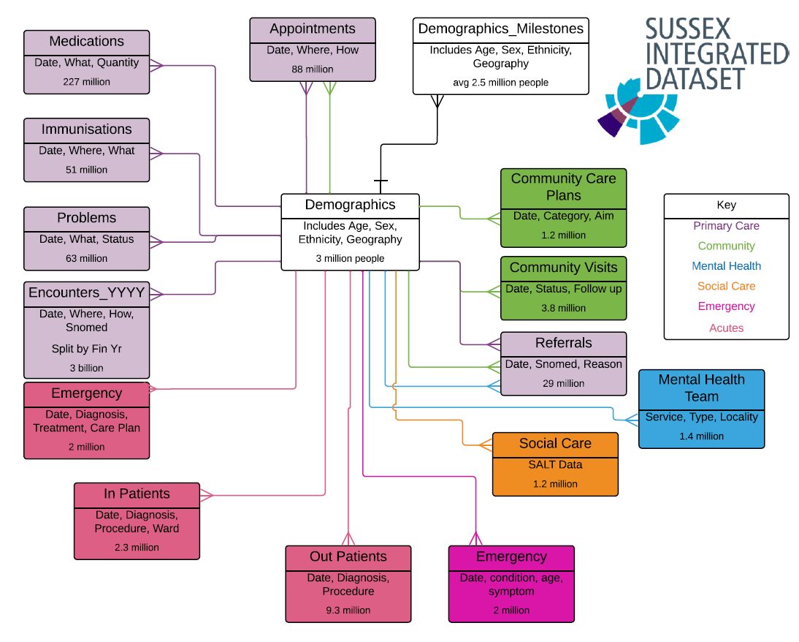
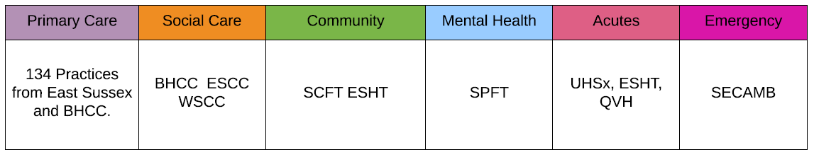

Slide 6
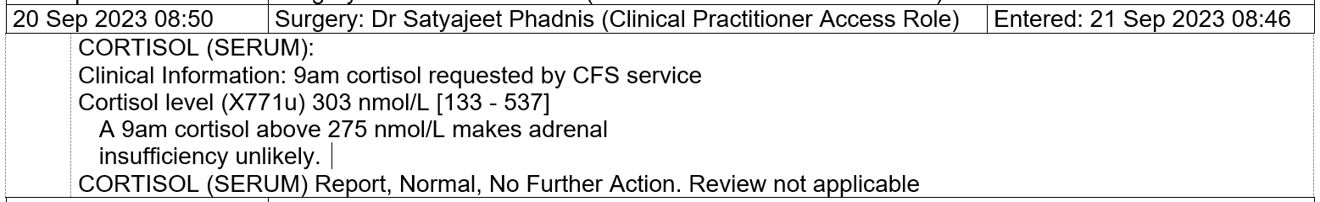
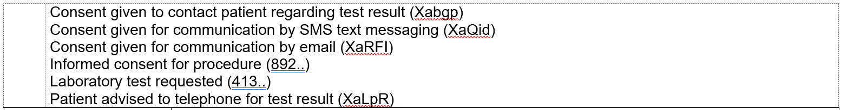
What does healthcare data look like (primary care)

Slide 7
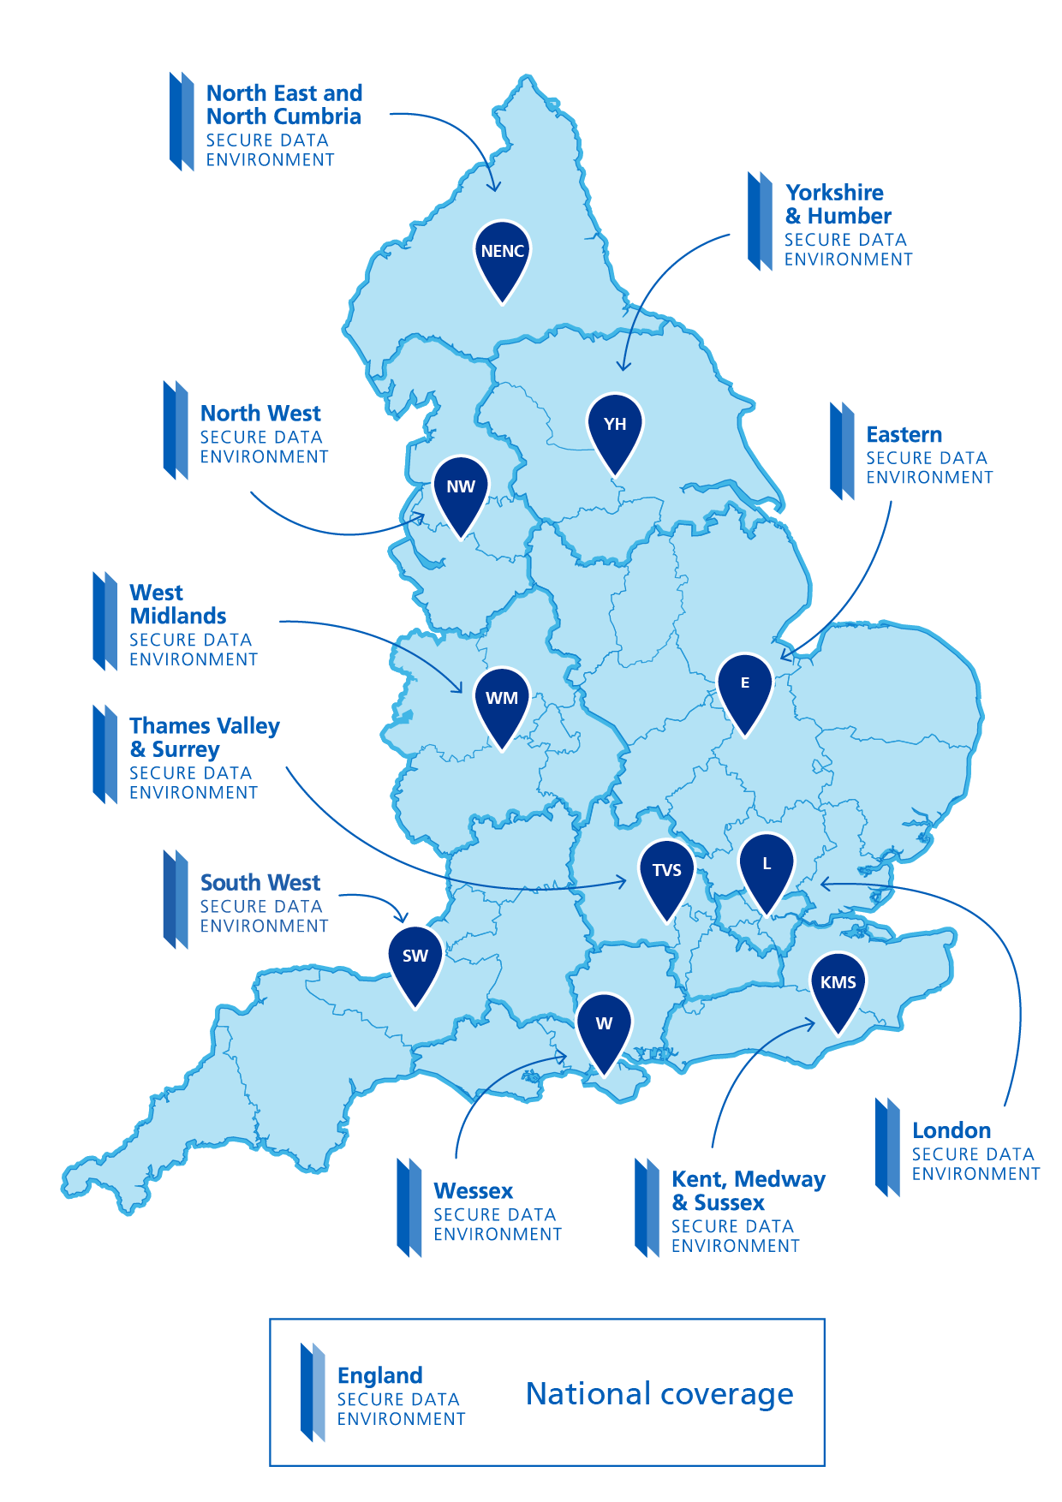
Secure Data Environments
All UK healthcare data, made available for research, is now hosted in a secure data environment.
Like a reading library, where you go in and sit and read the books in the library, you log in and access data within a protected environment.
Not like a lending library – you can’t take the data out of the environment and have it on your own computer.
Nationals SDEs and network of regional SDEs around England.

Slide 8
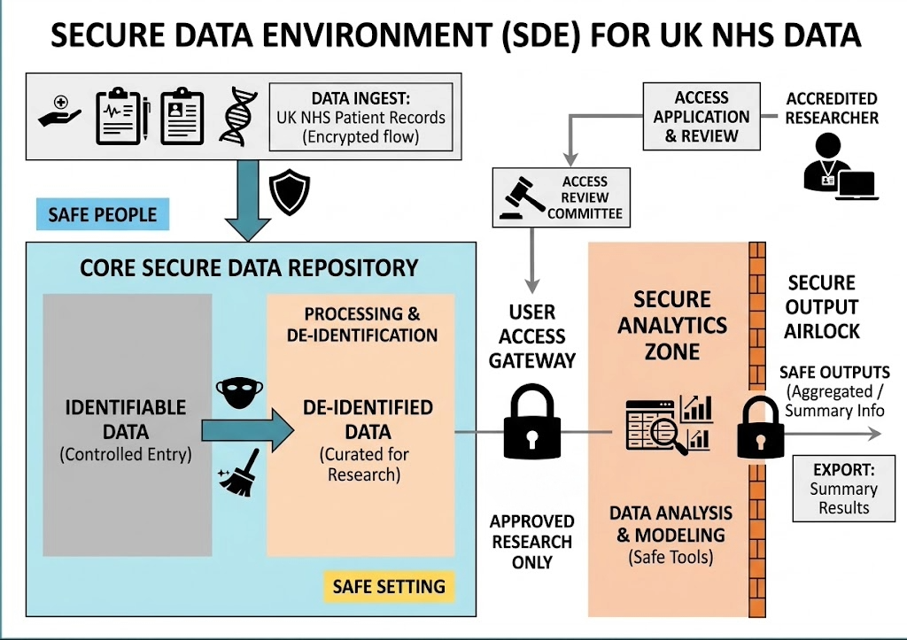

Slide 9

Why might I want to use NHS routinely collected data for my research?
Epidemiology and Drug Safety Research
Health Inequalities Investigations
Baseline System Needs Assessments
Prediction, Early Detection and Prevention
Testing Clinical Trial Recruitment and Follow up strategies

Slide 10
Thank you
Contact me:
Liz Ford e.m.ford@bsms.ac.uk
https://www.bsms.ac.uk/arcdatahub

Slide 11
Working with routinely collected health data
Key skills needed
Imogen Rogers
15/09/26

Slide 12
Accessing routinely collected data
Phases of data analysis project with routinely collected data
Structure of routinely collected data
Clinical code lists
Data preparation/wrangling
Working with routinely collected health data

Slide 13
Advantages and disadvantages of routinely collected data
Advantages
Disadvantages
Reduced time and cost of collecting data
Large sample sizes
Representativeness
  >95% of population registered with a GP
  Include groups hard to reach by conventional research methods. E.g. literacy problems, frail and elderly populations, deprivation
Data prospectively collected
Data not recorded for research purposes. Time consuming to process into an analysable form.
Data quality dependent on recording by clinicians
  Important information may be in text notes rather than coded fields
Contradictory information – e.g. different dates of diagnosis from hospital and primary care records
Missing data e.g. on BMI, smoking and drinking habits
  Data is unlikely to be MCAR
  Data quality may be different for different patient groups
Working with routinely collected NHS Data

Slide 14
Accessing routinely collected NHS data
Data is accessed via a Secure Data Environment (SDE)/Trusted Research Enviroment (TRE)
Local NHS SDE is the Kent, Medway and Sussex SDE (KMS-SDE)
  Sussex Integrated Dataset (SID) held within this SDE
All national datasets now accessed in this way
Complete a Data Access Request for approval.
A “virtual machine” is set up for the researcher in the SDE
  Researcher’s extracted dataset and any additional information e.g. clinical code lists are uploaded
  VM includes packages to run R and Python
  Can request specific packages to be installed
Presentation title

Slide 15
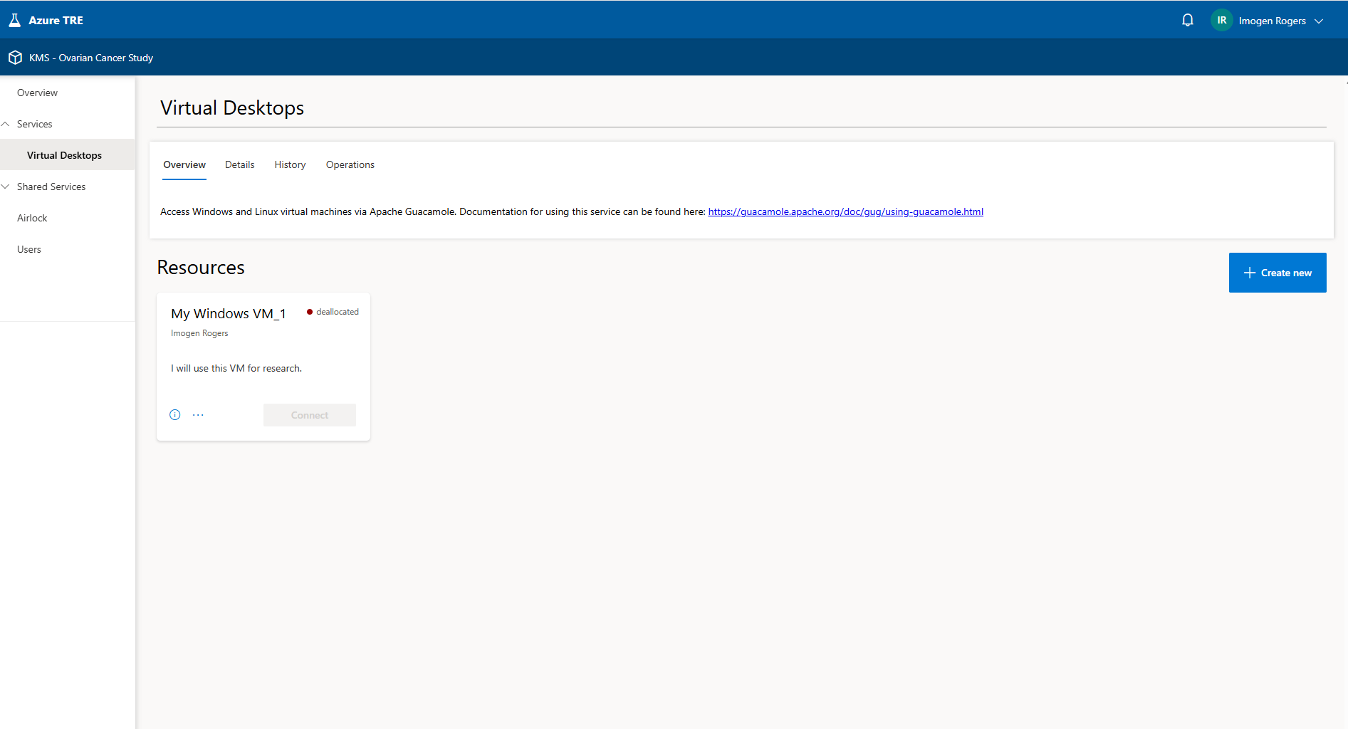
Working with routinely collected health data

Slide 16
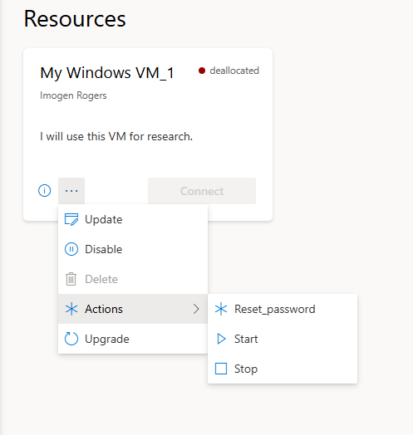
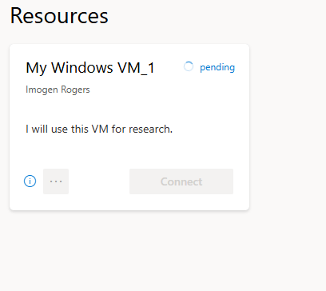
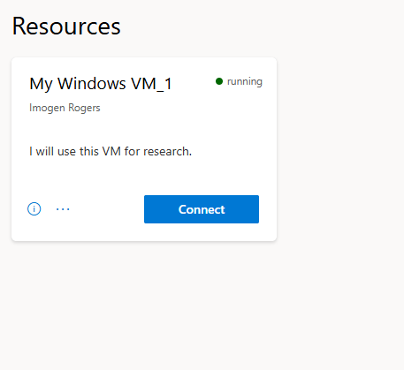
Starting the virtual machine
Working with routinely collected health data

Slide 17

Working with routinely collected health data

Slide 18
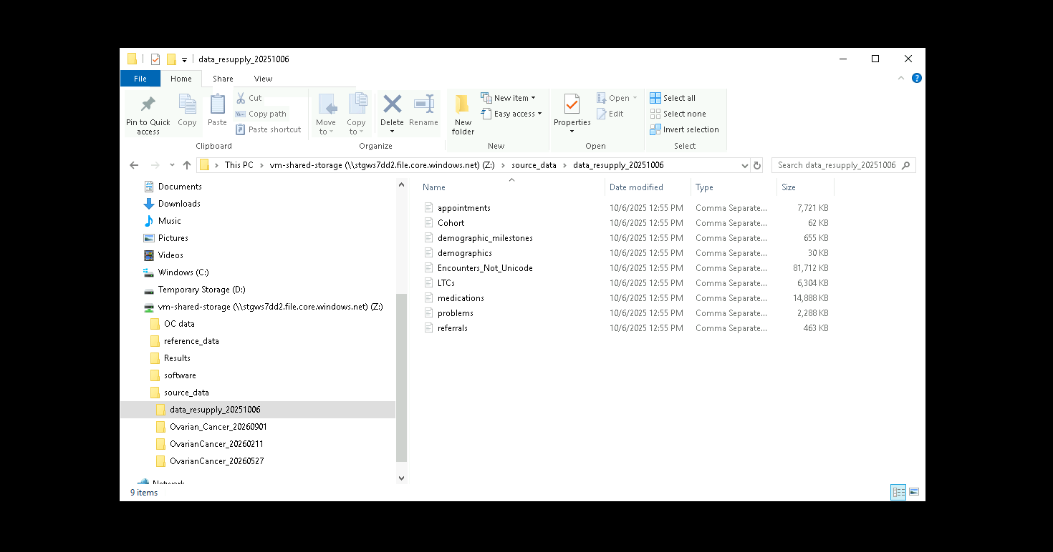
Working with routinely collected health data

Slide 19
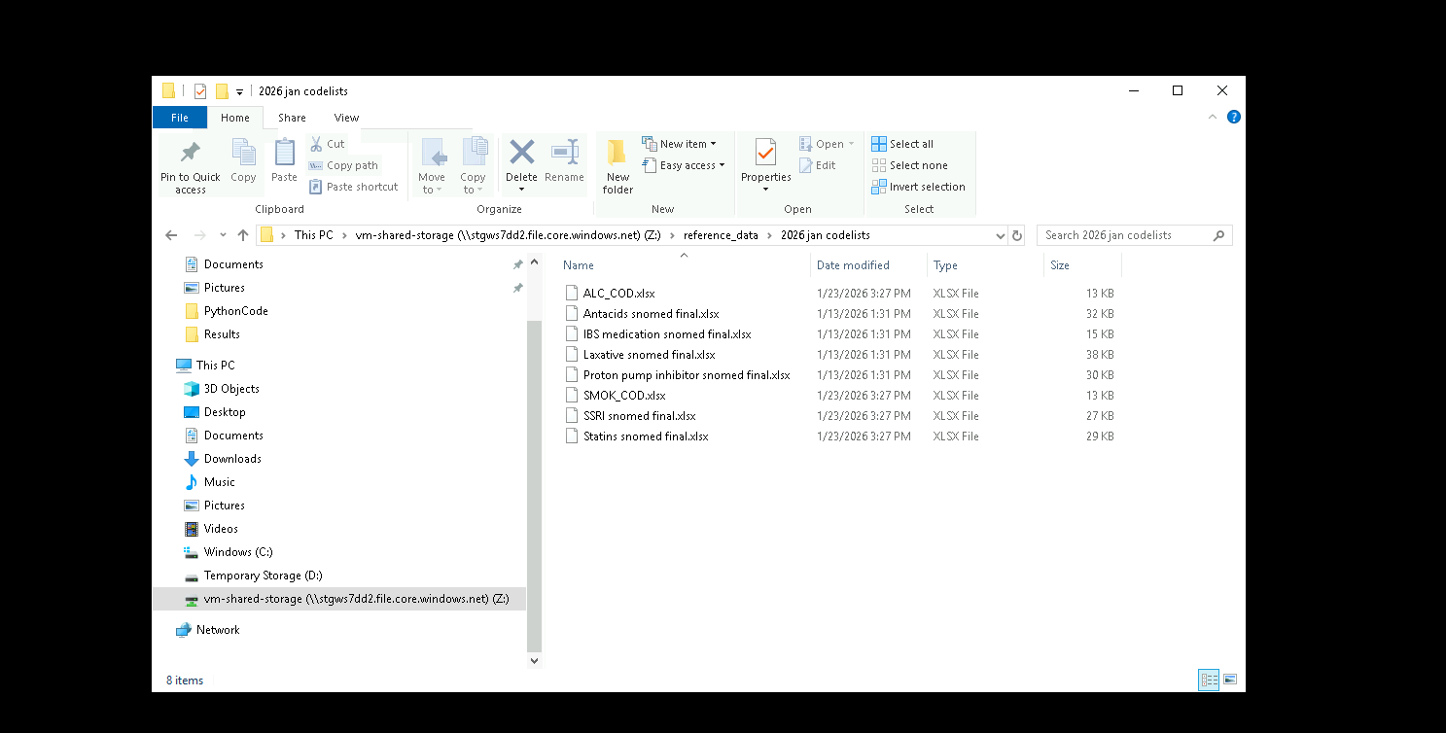
Working with routinely collected health data

Slide 20
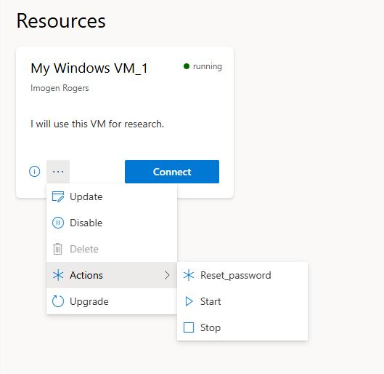
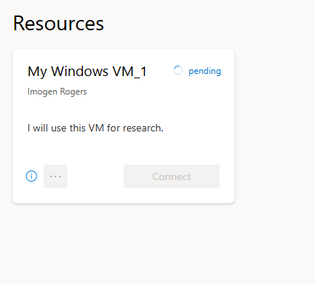
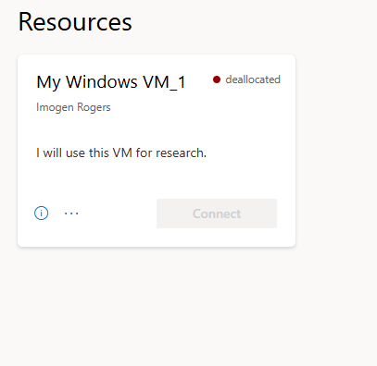
Don’t forget to stop the VM after use!
Working with routinely collected health data

Slide 21
Phases of the data analysis project
Presentation title

Slide 22
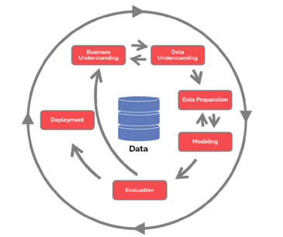
Phases of the data analysis project
CRISP-DM (Cross Industry Standard Process for Data Mining
When working with routinely collected health data:
Data Understanding – talk to clinician and check data availability!
      Research question – should develop taking into account limitations of available data
Preparing Data Access Request (can be difficult with limited meta-data)
  Waiting for Data Access Request Approval
  Registration to use the TRE/SDE
Waiting for data to be supplied
Code list preparation – allow plenty of time
  Waiting for code lists to be uploaded to TRE/SDE
Data preparation – again, allow enough time
May need data resupply
Waiting for results to be cleared and exported from TRE/SDE
Taken from Switrayana N et al, International Journal of Engineering andComputer Science Applications (IJECSA), vol. 2, no. 2, pp. 87 - 98, Sep. 2023. doi: 10.30812/ijecsa.v2i2.3406.
Working with routinely collected health data

Slide 23
Questions to consider when preparing DARF
What fields do you need?
    What derived variables will you produce
    Are these already defined in the SDE?
    Eg. Many diagnoses pre-defined in SID
Think about timescale for requested data
    How many years of data do you need?
    This may vary by variable and for specific codes
    Eg. to identify first versus repeat prescriptions and some comorbidities
    Getting this right initially can reduce need to request data resupply
.
Presentation title

Slide 24
Structure of routinely collected data
Presentation title

Slide 25
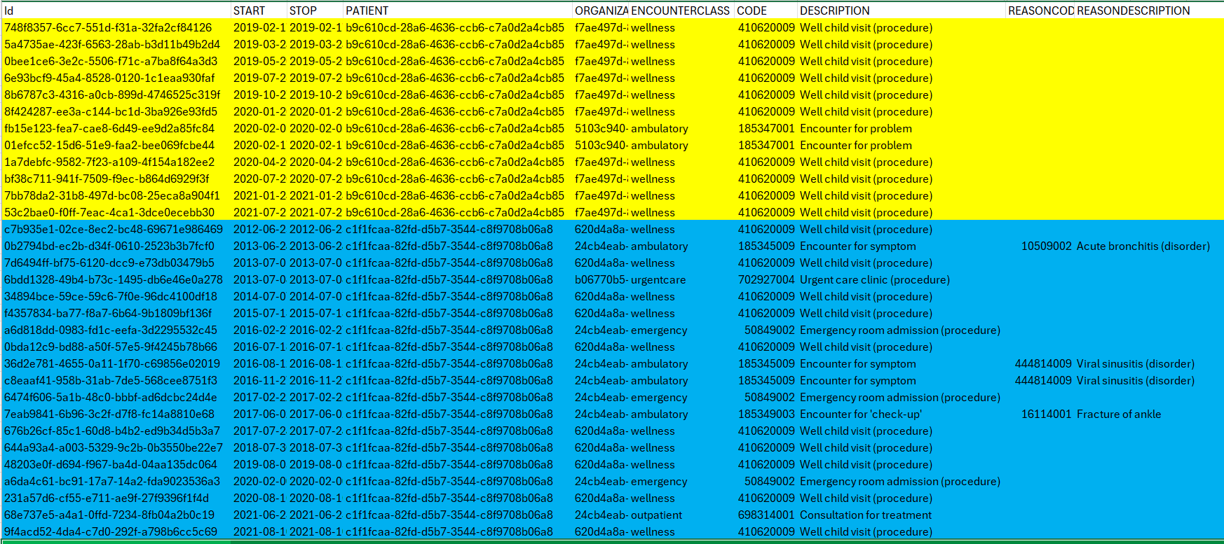
Example of the Synthea encounters data
Working with routinely collected health data

Slide 26
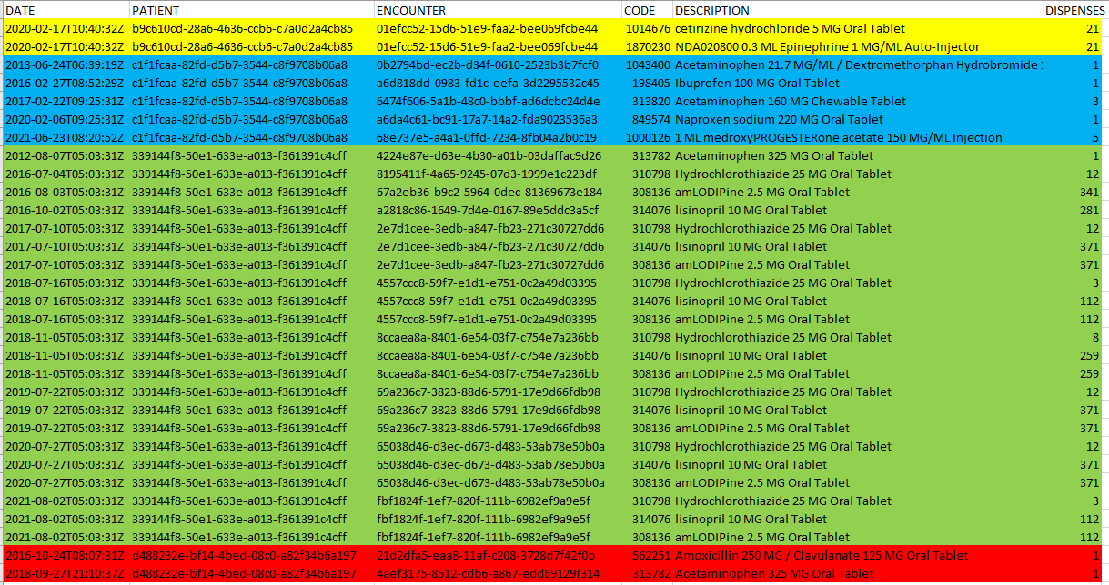
Example of the Synthea medications data
Working with routinely collected health data

Slide 27
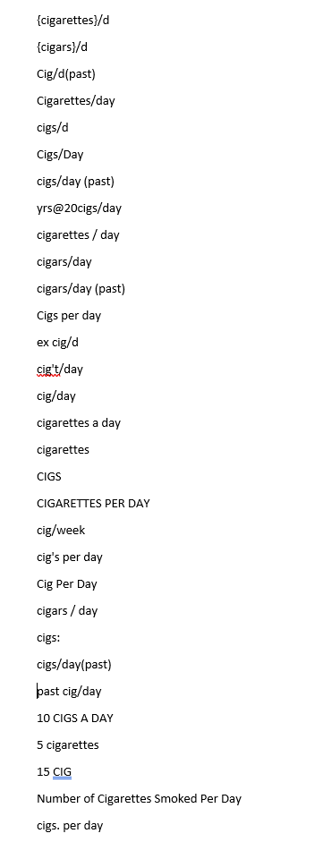
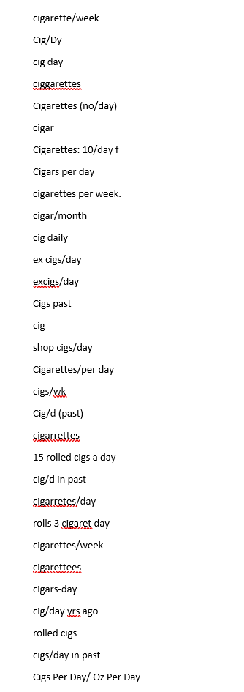
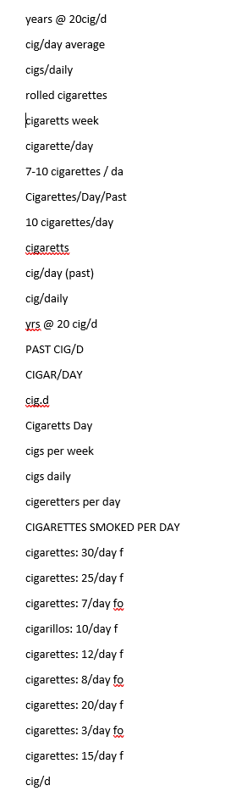
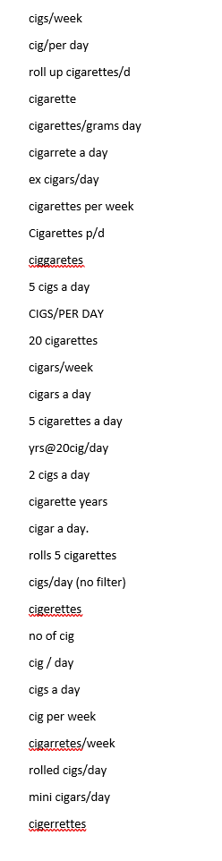
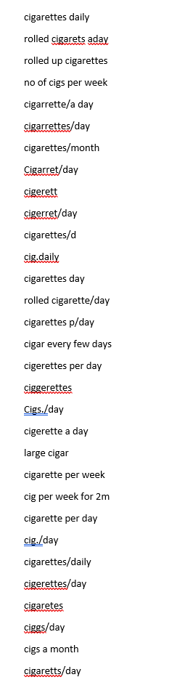
Measurement units relating to cigarettes/cigars in CPRD Aurum
Working with routinely collected health data

Slide 28
Clinical code lists
Presentation title

Slide 29
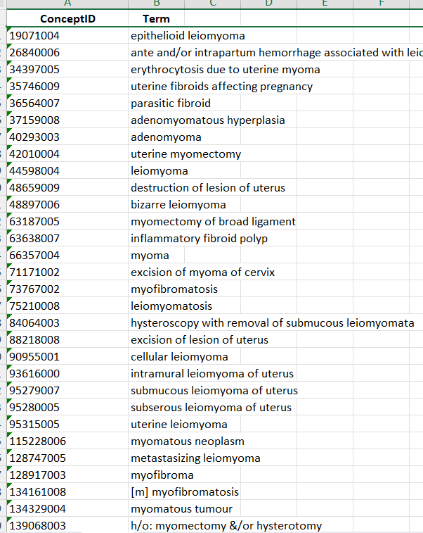
Clinical code lists
Most available data in Electronic Health Records available from coded fields
Multiple different coding systems in NHS data
  Primary care
    SNOMED codes (Read codes)
  Hospital data
    ICD10 codes
    OPCS codes
To create derived variables for analysis (e.g. diagnoses, medications, symptoms) will need lists of relevant codes
  Search for suitable pre-existing code lists
  Create new code lists by searching various databases
  Very important to review all code lists for suitability and consult a clinician
Working with routinely collected health data

Slide 30
Finding and creating clinical code lists
Finding pre-existing code lists
    Useful data bases include OpenCodelists and Phenotype Library | HDRUK Home
    Conditions included in QOF will have pre-defined code lists
Creating new code lists
    Searching SNOMED or ICD 10 or dm+d browser
    Clinical code dictionaries can be downloaded from NHS TRUD and searched directly
    CPRD provide a code browser
    Some codes appear under multiple names (e.g dm+d, VPID, APID all types of SNOMED code)
    NHS Digital have enquiries service (enquiries@nhsdigital.nhs.uk)
    Guide to creating code lists on ARC KSS Data Science Hub - BSMS
Take care when handling code lists to make sure long numerical codes are treated as text not numbers
Working with routine health data

Slide 31
Data preparation
Presentation title

Slide 32
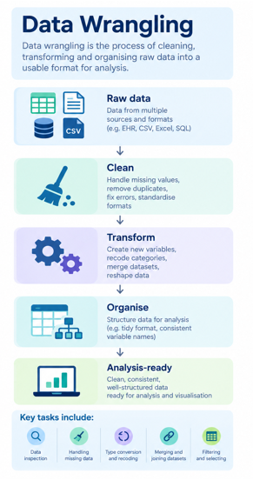
Data preparation/wrangling
Allow lots of time
    Vast majority of time is spent preparing data rather than running analyses
Can seem very intimidating
BUT
Limited amount of data manipulation processes to learn
    Selection (by code/date etc), recoding, aggregating, matching etc.
    Same tasks repeated many times
Making derived variables may have multiple stages
    Check output is what you expect at each stage
    Check numbers look realistic
Annotate your code!
Working with routinely collected NHS Data

Slide 33
Resources
Code from other researchers
    Most journals now require publication of code
SDEs may provide code templates
Resources on ARC KSS Data Science Hub - BSMS
    Code examples
    Links to courses in R and Python
ChatGPT good for coding queries but need to check
Synthetic data sets
    Useful for setting up code while waiting for data
    Some synthetic hospital data already available: Artificial data pilot - NHS England Digital
    Synthetic primary care data planned soon: Developing Artificial Primary Care Records - NHS England Data Science
Working with routinely collected NHS Data

Slide 34
Summary
Be aware of the limitations of the data when preparing your application and research question
Data wrangling is time consuming but is a logic problem, not a maths problem
Resources are available for data preparation, code lists directories and code list creation
Lead time for data access is very long so take this into account

Slide 35
Thank you
Imogen Rogers
Research Fellow in Health Data Science
I.Rogers@bsms.ac.uk

Slide 36


Working with CPRD data: my PhD experience
Dr Bria Browne
Centre for Dementia Studies
Brighton and Sussex Medical School

Slide 37


Navigating CPRD data: from starting out to working independently
My PhD topic – Identifying the physical, psychosocial, and systemic determinants of hospital readmissions among older adults living with dementia
What I used CPRD data for – Using electronic health records of a dementia population in England to identify clinical factors associated with 180-day hospital readmission and one-year mortality
Note: Less focus on PhD findings, more focus on experiences and lessons from working with CPRD

Slide 38
How I started with CPRD data
Received data
(Added as an analyst to an approved protocol under Dr Liz Ford)
Key areas:
Needed to understand how CPRD data were structured
Became familiar with different files and considered variables that could be developed from the data
Understood what information was relevant to my research question (confirmed diagnoses, follow-up dates of appointments/hospital admissions, dates of birth and death)
Gradually moved from understanding individual datasets to linking them together to help answer research question
Understood the files
(Different files for diagnoses, medications, consultations etc.)
Allow time!
Linked primary care data with hospital records
Identified my cohort
First and main challenge: understanding what the data represents before worrying about analysis
Clean data and apply analysis

Slide 39
Skills I needed to learn
Many of these skills I learned on the go
Data skills | Research skills
Python and R coding | Translating research questions into data
Data cleaning | Understanding clinical coding and code lists*
Creating algorithms to develop variables | Defining variables and cohorts
Dates & follow-up | Checking assumptions
Debugging/troubleshooting errors | Documenting decisions
Notes:
*Example provided in next slide

Slide 40
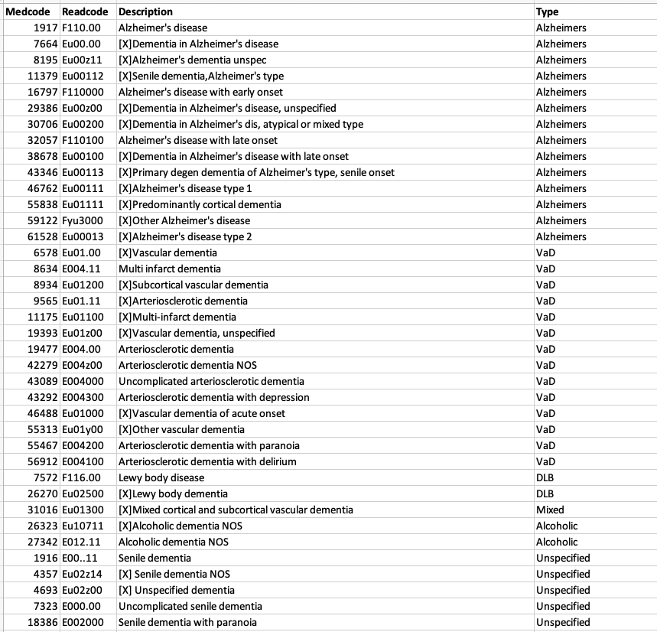
*Code list of dementia diagnoses
All young-onset dementia diagnoses removed – study specific
Need to know the dementia type for each diagnosis code (consult with a healthcare professional to confirm appropriate diagnoses)
Published code lists for clinical diagnoses available on Healthdata Gateway UK Phenotype Library website
Notes:
Example of understanding clinical coding using part of the code list for dementia diagnoses for my study. I ensured each diagnosis was relevant to the study using my nursing background and confirming with my lead supervisor (prof. of old age psychiatry). Important to check each code description in a code list as some may not be relevant e.g. young-onset dementia, diabetes code lists include ‘gestational diabetes’ which was also not relevant in my study

Slide 41
From guidance to independence
Support from Dr Imogen Rogers
🧑‍🏫
Guidance
Understanding CPRD structure
Examples from previous studies
❌
Things going wrong
Error codes / odd results
Breaking down the problem
Documentation, asking for help
🔎
Troubleshooting
Check possible reasons, understand, fix, re-run code
Less reliance on reassurance
💡
Confidence & independence
Knowing how to address a problem
Navigating CPRD more independently
💻
My own attempts
Writing my own code, repeating processes
Imogen’s support
My independence
Notes:
My experience with CPRD was really a progression from being quite dependent on guidance to eventually being able to navigate problems independently.
At the beginning, Imogen was really important in helping me understand the structure of the data and where to start. Then I started trying things myself, inevitably things went wrong. I would get errors, lose patients unexpectedly, or get results that just didn't make sense.
Over time, I got better at troubleshooting those problems myself. Instead of immediately asking for help, I learnt to go back through my code, check my patient numbers, check the documentation and work out where something had gone wrong. Eventually, I think the biggest change was that I became confident that even if I didn't immediately know the answer, I knew how to find it.

Slide 42
A key challenge with CPRD data
Developing accurate algorithms for desired variables
  Clinical coding systems not originally designed for research purposes multiple steps required to collect the correct data in the correct timeframe to develop a variable
  E.g. Polypharmacy - presence of 5 or more medication codes in any 90-day window between dementia diagnosis date and index hospital admission date
  (not a readily available variable)
What helped:
Developing other (less complex) variables with timeframes required to build knowledge and confidence in data availability and coding
Trial and error with desired variable
Published studies which used CPRD data
Reviewing problem areas with Dr Imogen Rogers

Slide 43
What became manageable
Developing familiarity with the data
Creating variables – was able to later revise code independently when required
Running analyses
Checking patient numbers at each stage, considering potential reasons for change
    E.g. suddenly lost 1000’s of patients Missingness in variables? Filtering code correct in subgroup analysis?
Translating numerical output from real-world healthcare data into meaningful findings

Slide 44
What to know before using CPRD
Understand your data before worrying about the analysis stage
Document everything regularly
(variable definitions, code backups, study decisions)
Keep checking your patient numbers at each stage (joining, filtering, excluding patients)
Working with real-world data is iterative and requires time
My experience: 2 steps back, 1 step forward

Slide 45
Thank you!
Email: b.browne@bsms.ac.uk

Slide 46

Final messages
Many resources available on the ARC KSS Data Science Hub
    ARC KSS Data Science Hub – BSMS
    Information on how to access data sets, links to courses, code list preparation and code lists, guide to data preparation
Part of our role is to support capacity building so please get in touch
Presentation title

