Slide 1
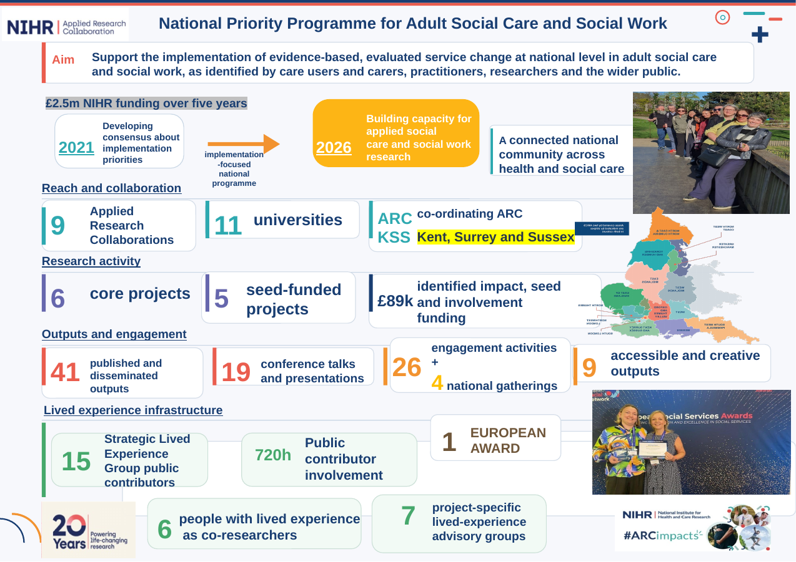
From Partnership
to Impact
Lessons from the National Priority Programme for Adult Social Care and Social Work
Partnership • inclusion • co-production • implementation learning
Dr Madalina Toma| ARC KSS Research Week|

Slide 2
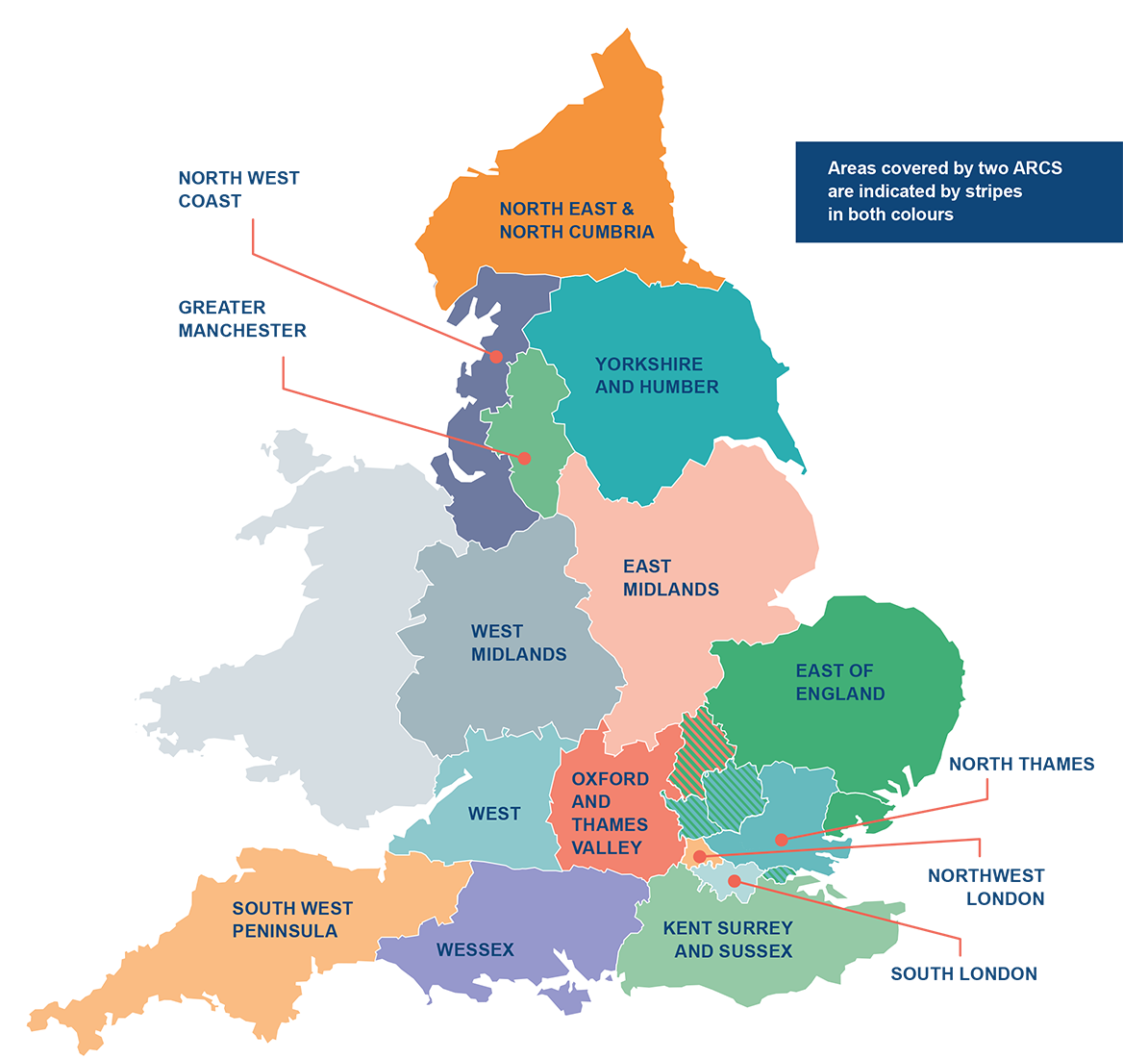
National Priorities Programme for Adult Social Care and Social Work
Aim: Support the implementation of evidence-based (evaluated) service change at national level in adult social care and social work (ASCSW) …
…. as identified by care users and carers, practitioners, researchers, and the wider public.
Funding from NIHR over five years (3 original +2 extension)
ARC Kent, Surrey and Sussex (lead)
ARC Oxford and Thames Valley
ARC East of England
ARC West
ARC West Midlands
ARC North East and North Cumbria
ARC North Thames
ARC South London
ARC North West Coast

Slide 3
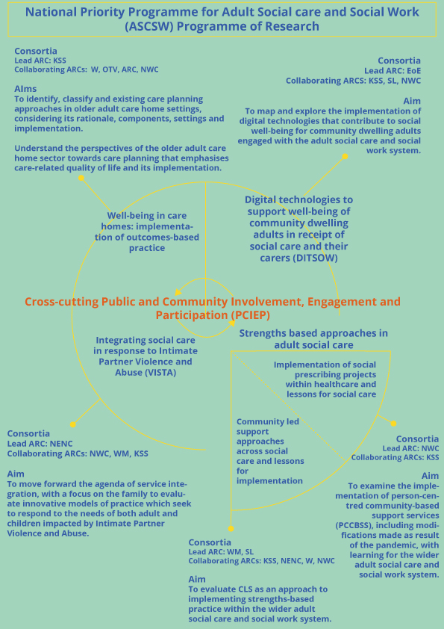
Developing consensus about Implementation Priorities
Building capacity for applied social care and social work research

Slide 4

Wellbeing in care homes:
Implementation of (outcomes-based) care planning
Lead ARC: KSS (Kent, Surrey and Sussex)
Objectives: To inform the further development of quality of life (QoL) approaches towards care planning (CP) in older adult care homes
  Phase 1
  Scoping review of CP interventions in care homes; Consultation- interviews with relevant stakeholders about CP barriers and facilitators; Developing a framework to understand what person-centred care planning entails
  Extension phase Consensus process with stakeholders about implementation of best practice in CP; Small pilot and process evaluation of specific social care related quality of life measures
  Seed funding projects:Developing collaborative research proposals in the area ; Co-designing advance CP with people living in care homes
  Impact: A co-produced guide to enhancing QoL through CP in care homes, increasing understanding of how the ASCOT tool can be applied and used effectively in CP practice.

Slide 5

Digital technologies to support social wellbeing of community dwelling adults in receipt of social care and their carers
Lead ARC: EE (East of England)
Objectives: To map and explore the implementation of digital technologies (DT) that contribute to social well-being for community dwelling adults engaged with adult social care and social work services
  Phase 1: Scoping review; Interviews and focus groups with commissioners, tech providers and older adults about DT value and adoption, to develop and co-produce best practice guidelines and recommendations about how to adopt effective DTs
  Extension phase: understanding of the challenges and facilitators of DT use for older adult with vision loss; using DT to support people with dementia and build capacity in the collection and use of evidence in this area
  Seed funding project: Co-creation of information resource accessible to the VL community to support DT use for independent and connected living.
  Impact: Co-produced recommendations to guide the design, evaluation, and implementation of DT, leading to more successful adoption of DT for people with vision loss and dementia.

Slide 6

Integrating social care in response to intimate partner violence and abuse: Supporting the adult and child victim
Lead ARC: NENC (North East and North Cumbria)
Objectives: to evaluate innovative models of practice which seek to respond to the needs of both adult and children impacted by intimate partner violence and abuse (IPVA)
  Phase 1:
  Systematic review exploring experiences and attitudes around best ways of responding to the needs of parents and their children who are victims/survivors of IPVA; Survey and interviews to identify innovative practice models
  Extension phase: co-produce best practice recommendations and toolkit to help responding to the needs of child and adult victim/survivors of IPVA; piloting the toolkit and evaluating it in across the participating ARCs.
  Impact: A toolkit offering a step-by-step guide for local authorities to plan, embed, and review new approaches to supporting families affected by domestic abuse, shaping debate, strategy, and long-term policy on family safeguarding.

Slide 7

Strengths based approaches:
Implementation of person-centred community-based support services within health care and lessons for social care
Lead ARC: NWC (North West Coast)
Objectives: To examine the implementation of person centred community based services
  Phase 1: Review of PCCBSS documents and materials; Interviews to explore further implementation of PCCBSS, including barriers and facilitators
  Extension phase: Co-design and pilot a best practice recommendations and a toolkit that consider how the PCCBSSs are implemented and what the lessons are for adult social care.
  Seed funding project: developing guidance and practical tools to support social prescribers respond to very complex or serious safeguarding concerns
  Impact: A toolkit that helps communities connect with local resources, strengthens provider relationships, and improves sustainable signposting services to enhance service users’ wellbeing.
Notes:
Working with NDTI

Slide 8

Strengths based approaches:
Community-led support (CLS) approaches across social care and lessons for implementation
Lead ARCs: WM (West Midlands) and SL (South London)
Objectives: To evaluate CLS as an approach to implementing strengths-based practice within the wider system.
  Phase 1
  Review of CLS documents and materials; Interviews to explore leadership, culture change, co-production and use of data; Process evaluation in three sites to explore perceptions of effectiveness; Comparing CLS and non-CLS sites, looking at differences in process and service outcomes
  Extension phase: evaluate how sites which are new to CLS are engaging with these approaches, and undertake focused work assessing the implementation of the community hubs
  Seed funding project: Creating a film which shares the insights of the research into community hubs
  Impact: A best practice guide and toolkit on community hubs, informed by research into how their location and partners influence engagement, to strengthen co-production and delivery
Notes:
Working with NDTI

Slide 9

Cross-cutting Public and Community Involvement, Engagement and Participation
Lead ARC: WM (West Midlands)
  Phase 1:
  Supported specific projects within the NPP
  National group of 15 people with lived experience established
  An evaluation of PCIEP across the NPP - about ways to best ensure PCIEP impact
  Template and process for all NPP projects to record and report on PCIEP activity
  Extension phase co-create recommendations on how PCIEP can meaningfully and effectively support implementation and increase research impact within ASCSW
  Impact: Recommendations and co-created resources to strengthen PCIEP, guide NPP projects, support collaboration between researchers and people with lived experience, and share learning with the wider social care research community.
Notes:
Working with NDTI

Slide 10

Lessons learned: what made partnership work
• Start with shared priorities, not just shared funding. The NPP began from nationally agreed adult social care and social work priorities, then gave projects room to respond to local realities.
• National coordination needs local delivery. Coordination created consistency, shared learning and spread, while local ARC partnerships kept the work grounded in practice, providers, local authorities and lived experience.
• Collaboration is active work. Trust, communication and alignment did not happen automatically; they needed time, coordination and sustained commitment across ARCs and partners.
Takeaway: partnership was not a backdrop to the research — it was part of the implementation method.

Slide 11

Lessons learned: inclusion has to be built in
• Involvement needs infrastructure. The Strategic Lived Experience Group, project advisory groups and lived experience co-researchers gave PCIEP a visible place in governance, design, evaluation and dissemination.
• Counting activity is not enough. Templates, reporting processes and evaluation helped projects ask where lived experience changed decisions, not only whether people had been consulted.
• Inclusive working needs flexibility. Adult social care research must be accessible across different communities, settings, communication needs and starting points.
Takeaway: co-production became stronger when it was resourced, recorded and connected to decision-making.

Slide 12

Lessons learned: implementation is local
• One programme, many contexts. Care homes, local authorities, community organisations, providers and voluntary sector partners needed different routes into the same national priorities.
• Frameworks helped, but adaptation mattered. Projects used implementation and sustainability approaches to understand what works, for whom, in what contexts, and how evidence can be adopted and adapted.
• Practical outputs mattered. Toolkits, guides, films, recommendations and implementation resources made the research easier to use in real services.
Takeaway: national impact depends on making evidence adaptable enough for diverse social care systems.

Slide 13

Lessons learned: impact needs capacity
• Evidence alone is not sufficient. Impact depended on implementation support, leadership, relationships and organisations able to use research.
• Capacity building and implementation reinforced each other. Research activity created learning opportunities; increased capacity created better conditions for evidence to be adopted and sustained.
• Legacy needs planning before the end. Communities of practice, national networks, follow-on projects and practical resources helped sustain momentum beyond individual project funding.
Takeaway: the lasting value of the NPP is the platform it created for future adult social care research and implementation.

Slide 14
For future collaborative research programmes
• Design partnership early. Allow time and resource for relationship-building, shared governance and coordination across organisations.
• Make inclusion a programme-wide responsibility. Embed lived experience across decision-making, not only at project consultation points.
• Plan for use, spread and sustainability. Build implementation resources, capacity and leadership into the programme from the start.
Final message: from partnership to impact means investing in the conditions that help evidence travel.

Slide 15

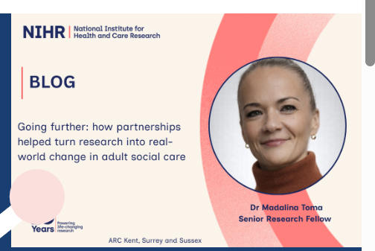
m.toma@kent.ac.uk
https://arc-kss.nihr.ac.uk/news/blog-going-further-together-how-partnership-helped-turn-research-into-real-world-change-in-adult-social-care

