Slide 1

The Participatory Approach to Research- Addressing Barriers to Inclusion
Bernadette Egan & Tara Cahill-Powell
15/09/26

Slide 2

Outline of today’s session
Introduction to Participatory Research
Participatory tools and methods
Group activity
Ethical Concerns & Challenges
Q&A
The Participatory Approach to Research

Slide 3
Introduction
The Participatory Approach to Research

Slide 4
What do we mean by Participatory Research?
Definition
Participatory research is a collaborative approach where members of the community and stakeholders act as co-researchers alongside academics. This approach moves away from treating individuals as ‘research subjects’ to empowering those directly affected by an issue to have a voice and be active in designing and delivering research and effecting change.
The Participatory Approach to Research
Notes:
Other terms that come to mind are Public Involvement & Engagement, Co- production. Spectrum of involvement which Tara will talk about .
Research WITH people , not ON people,

Slide 5
What do we mean by Participatory Research?
Traditional approaches to research involved researchers defining research questions, collecting data, and interpreting findings independently.
In contrast, participatory approaches encourage shared decision-making throughout the research cycle. Community members can contribute to identifying research priorities, collecting data, interpreting findings and disseminating findings.
The Participatory Approach to Research

Slide 6
Participatory Research- Core Philosophy
Participatory research is founded on the values of collaboration, mutual learning, democratic knowledge production, and social justice.
A central tenet is that expertise exists in many forms. Academic knowledge is important, but equally important is the knowledge derived from lived experience.
A key principle of participatory approaches is the redistribution of Power within the research process.
The key distinction between participatory and conventional research lies in the "location of power" within the research process. Participatory research shifts control away from researchers and towards a more equitable partnership with those whose lives are the focus of the research. Cornwall and Jewkes (1995).
The Participatory Approach to Research
Notes:
Briefly touch on the philosophy underpinning these methods.

Slide 7
Participatory Research- What is Power?
Power is the ability to influence decisions, shape research, and determine whose knowledge, perspectives, and priorities are valued.
The Participatory Approach to Research

Slide 8
Where does Power come from?
Power emerges in relationships: people have power in relation to one another
Power markers: academic expertise, professional status, control over research questions, ownership of data, language/jargon, time/resources, cultural expertise, local knowledge, etc.
Power is not individual, it is:
Institutional – conferred by organisations, roles, or formal processes
Structural – created by wider social, economic, and political systems
Historical – shaped by past experiences and relationships
The Participatory Approach to Research
Notes:
Important to recognise this so that any issues can be addressed.

Slide 9
Participatory Research and Research Inclusion
Participatory research can help to make research more inclusive.
Traditional approaches can unintentionally exclude groups whose voices are seldom heard in research, including:
        people with disabilities
        minoritised communities
        socioeconomically disadvantaged groups
        children and young people
        older adults
        individuals with lived experience of health or social challenges
The Participatory Approach to Research
Notes:
We are speaking today about research inclusion, so this seemed an appropriate topic.
Caveat- some of these groups can be over-represented in certain studies but underrepresented in studies that shape broader social/health policies. Normalised absence/pathological presence.

Slide 10
Participatory Research and Research Inclusion
From an inclusion perspective,
Participatory Research is not simply a
method or a tick box exercise but an
ethical commitment to ensuring that
those most affected by research have
a voice and opportunities to shape
the research
The Participatory Approach to Research

Slide 11
Participatory Research and Research Inclusion
By involving different groups/communities participatory research can help to:
Ensure research is addressing community priorities
Increase the relevance and cultural appropriateness of research methods
Improve trust and engagement between researchers and communities
Generate meaningful findings that are applicable in real-world settings.
Empower individuals and communities by valuing their expertise and lived experience.
Support more equitable and socially responsive knowledge production
The Participatory Approach to Research
Notes:
Benefits are enormous

Slide 12
Participatory tools and methods
The Participatory Approach to Research

Slide 13

Health Determinants Research Collaboration Surrey
HDRC Surrey is all about making Surrey a healthier place to live, by strengthening how local government generates and uses research to shape decisions that truly reflect the needs of the community.
Find out more about HDRC Surrey here:
Home | Surrey HDRC
The Participatory Approach to Research

Slide 14
Participatory tools enable greater engagement and power for participants
Participatory tools are qualitative methods designed to be interactive and visual. These methods can be helpful in overcoming traditional power imbalances or language barriers.
1. Tools to understand the community structure/ the area:
e.g. Community mapping, Transect walks
2. Tools to understand community/ group perspectives:
e.g. Problem Tree, Vignettes and illustrations, Storytelling
3. Tools to understand individual experiences:
e.g. Photovoice, collage, body-mapping, River of Life
4. Tools to co-design desired outcomes:
e.g. Stepping stones
The Participatory Approach to Research

Slide 15
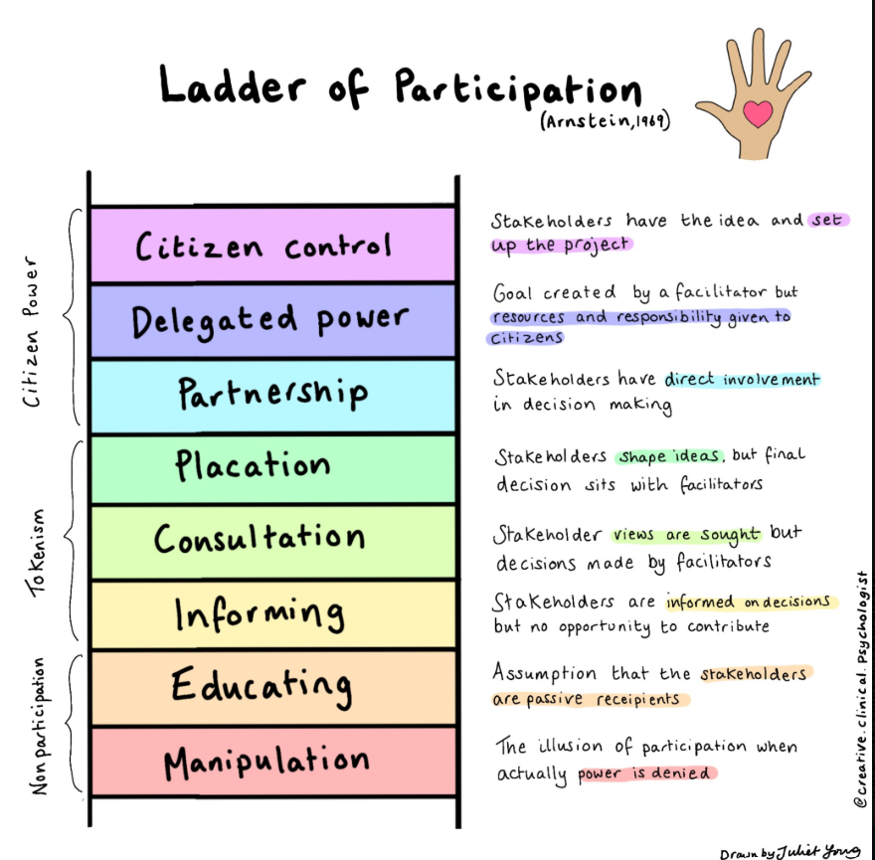
N.B! Participatory tools on their own do not make a whole research project participatory…
Using a participatory research method is a way of increasing participation in one element of the research process but does not on its own mean that something would be “participatory research”.
For something to be truly participatory then participants need to be co-designing every stage of the research (the design, data collection, analysis and dissemination), not just involved in data collection.
The Participatory Approach to Research

Slide 16

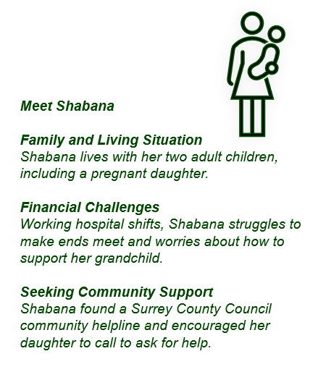
Storytelling & Story Circles
Storytelling
Story circles
Storytelling is a tool that can be used to understand how people think about and understand a certain topic without getting into their personal stories.
Photos or ‘vignettes’ may be used as prompts to guide the discussion. Participants are asked to tell a story about what is happening in the photo or other visual prompt, as well as to share other reactions.
Provides groups with a safe, structured space to share short personal stories on a shared theme, helping build trust and share experiences.
Form a circle; each person shares around a theme speaking for 2–3 minutes each without interruption
Active listening (no interruptions) from other group members
Identify common threads and differences
Capture themes on sticky notes for next steps
The Participatory Approach to Research

Slide 17



Photovoice
How to use it:
Agree research focus, e.g. How well are bus services working for people in Surrey?
Asking participants to take photos of anything related to the research question.
The participant then talks through their photos and what is important to them and what issues are raised by the images.
Benefits
Enables participants to guide their input, allowing more control/power than in a traditional interview.
Useful for someone less confident in speaking, e.g. younger person.
And with permission – photos might aid further analysis or be part of the outputs.
The Participatory Approach to Research

Slide 18
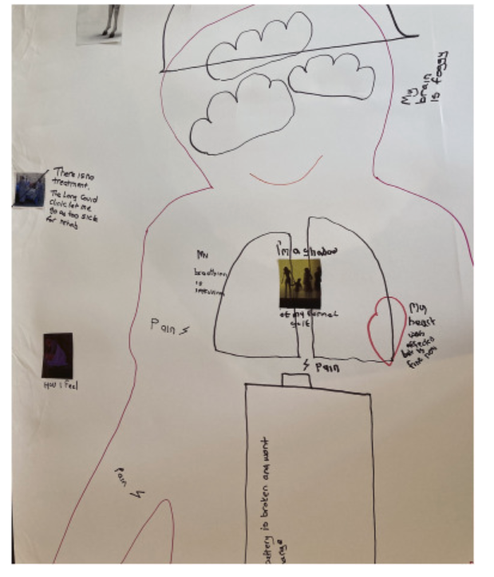
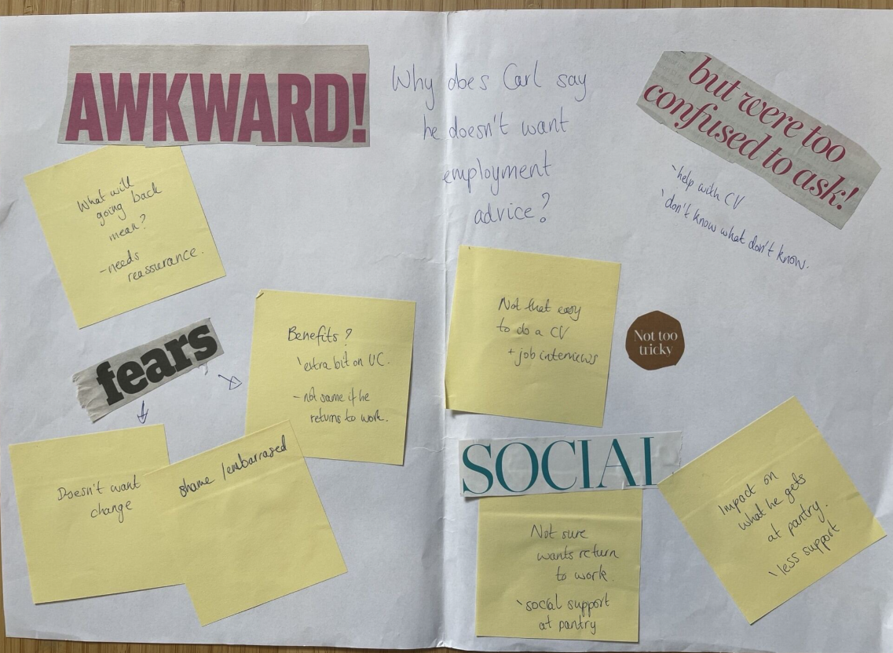
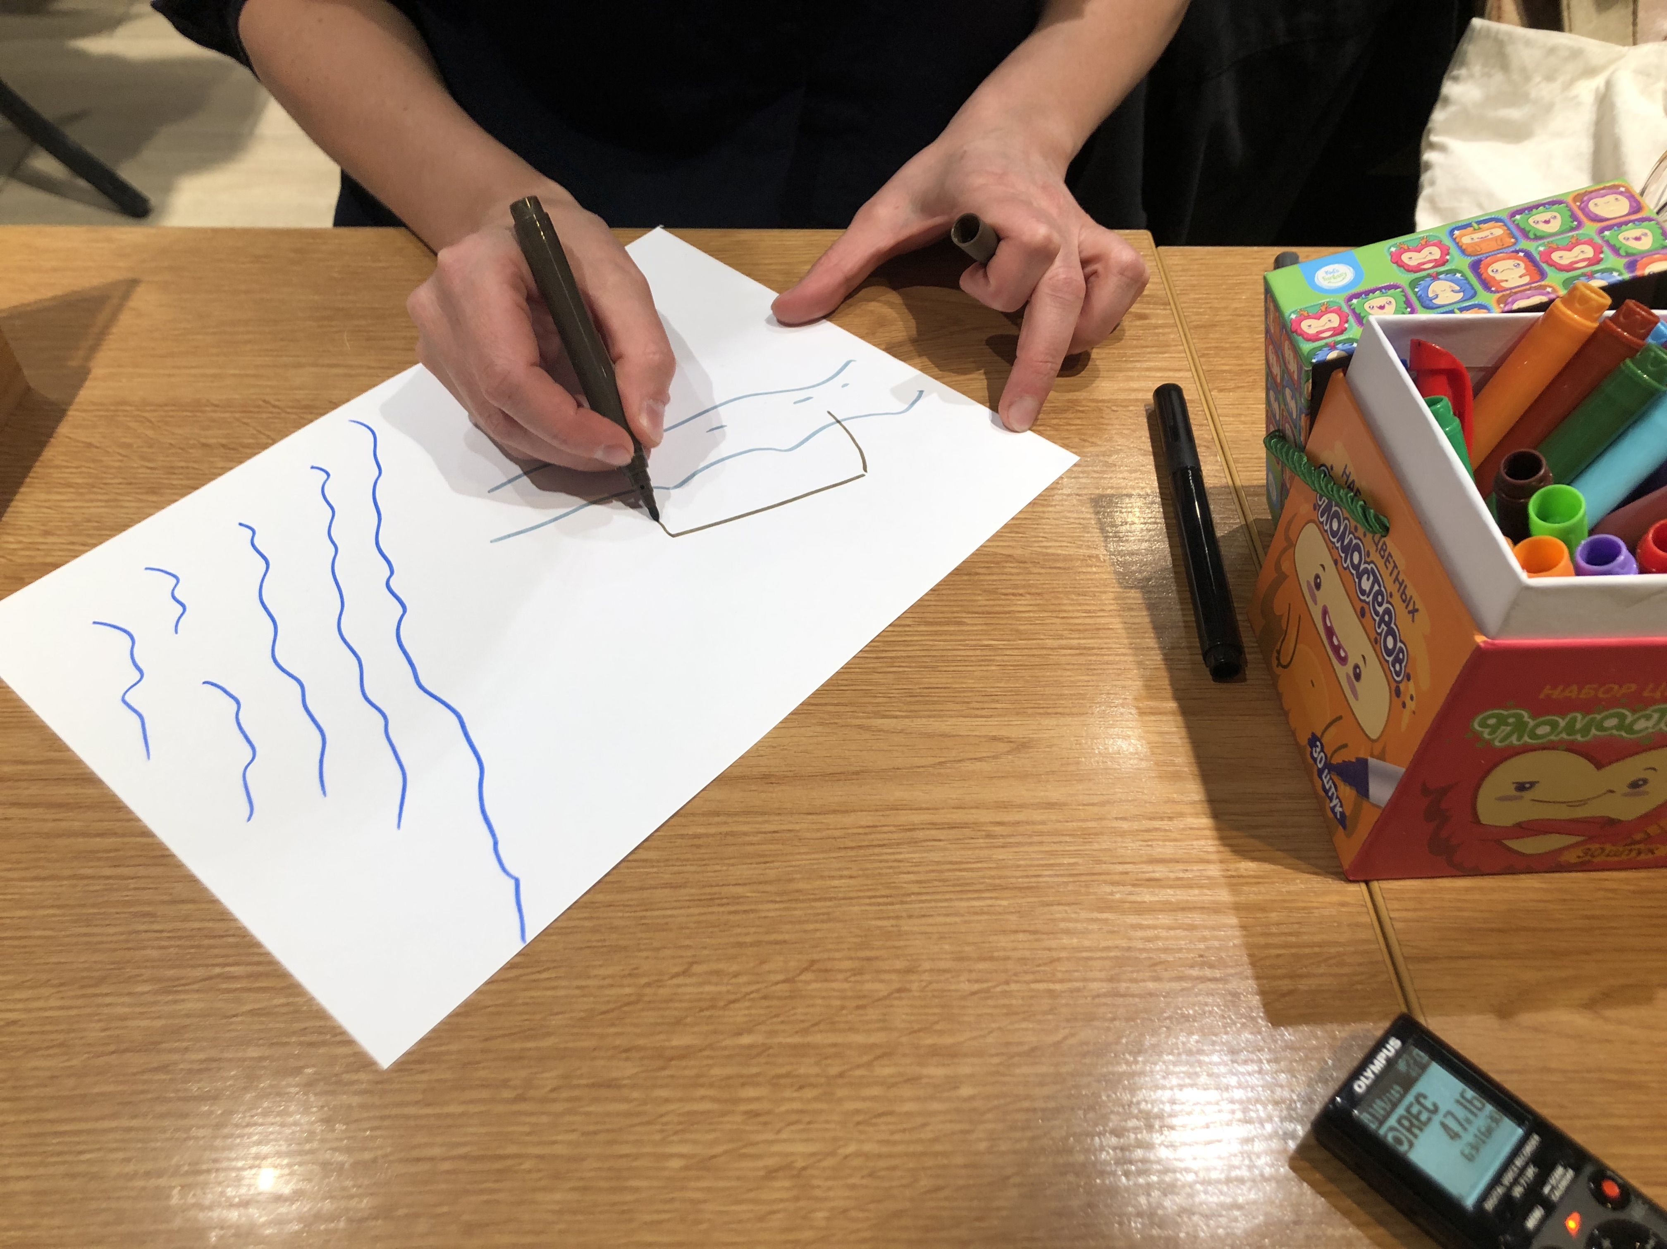
Other creative methods
By providing creative activities that allow participants to express experiences and ideas through images or performance, insights may be revealed that may not emerge through conversation alone.
How to use it:
Outline the activity you would like participants to create – e.g. a collage, a drawing, or a ‘river of life’.
State a question or topic you would like them to explore using this method.
The participant then talks through their creation and what it means to them.
The Participatory Approach to Research

Slide 19
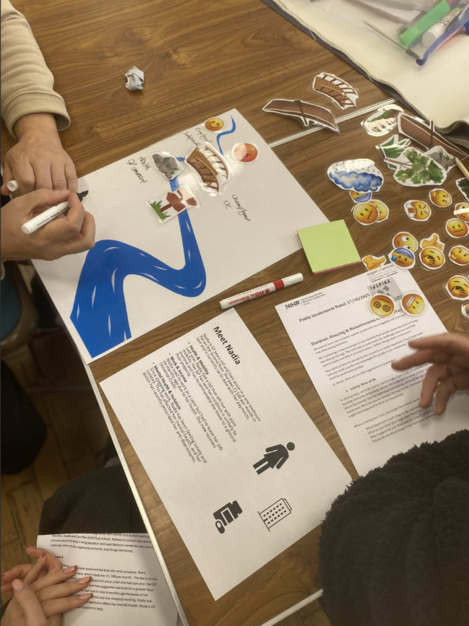

Example of participatory methods in practice
Housing Insecurity and Homelessness in Reigate &
Banstead: Evidence to Inform Early Prevention and
Support
Research ideation session – Reigate and Banstead Borough Council: collage
HDRC Surrey Public Involvement Panels
River of Life and vignette approaches
The Participatory Approach to Research

Slide 20
Group Activity
The Participatory Approach to Research

Slide 21
Interactive Activity- 15 minutes
We are heading into Breakout Rooms for about 6 minutes to discuss research inclusion in a hypothetical study.
Our Scenario: "The PATH-MH Project" You are reviewing a study aiming to co-design mental health pathways for new mothers and older adults.
Your Task: Identify at least TWO hidden barriers to research inclusion in the current traditional plan and how these might be addressed. Think about physical, digital, cultural, or financial exclusion.
Appoint one person to keep time and be ready to share your top barrier in the chat when we return!
The Participatory Approach to Research

Slide 22
The PATH-MH Project- Accessing Pathways to Mental Health
The Study: The PATH-MH Project (Accessing Pathways to Mental Health)
The Goal: A 2-year study evaluating the accessibility of community-based mental health services. The team aims to co-design a new digital-and-physical hybrid referral pathway.
The Target Demographics:
Low-income, new mothers experiencing postnatal depression.
Older adults (aged 75+) living alone with mild cognitive impairment.
The Current Traditional Plan: Participants will be recruited via clinic posters with QR codes, required to attend three 90-minute evening focus groups hosted on Zoom, and fill out a 20-minute online baseline health literacy survey.
The Participatory Approach to Research

Slide 23
The PATH-MH Project- Accessing Pathways to Mental Health
Low-income mothers
Barrier: Evening Zoom calls- childcare /lack of private space
Solution: Photovoice via mobile- photos taken during the day of barriers to accessing support. Share photos via a secure , text-free or low text platform e.g. private WhatsApp group
Barrier: Online surveys & QR recruitment – language barrier/ impersonal/ mistrust of health authorities
Solution: Paid peer researchers- recruit mothers from the local community to be co-researchers. Recruitment of other mothers through local playgroups/cultural centres etc
Older adults with mild cognitive impairment
Barrier: 90- minute Zoom focus groups-exclusion of those without internet or computers/ attention fatigue/ screen strain
Solution: In-person co-design- partner with trusted local hubs e.g. day centres, lunch clubs and conduct short in person sessions
Barrier: QR codes& online survey-cognitive overload, low digital literacy
Solution: Visual participatory mapping- provide a printed layout of proposed pathway and use color stickers to identify areas and processes that would causing concern.
The Participatory Approach to Research

Slide 24
Ethical Concerns & Challenges
The Participatory Approach to Research

Slide 25
Ethical Concerns & Challenges
Power & tokenism
  Is participation genuine or symbolic?
  Are community members being consulted but are researchers controlling key research activities?
  Who sets the agenda/who makes key decisions/who benefits from the research
Ownership of Knowledge and Data
  Who owns the findings?
  Who controls access to data?
  Who decides how findings are interpreted?
  Who receives credit for contributions?
Representation and Inclusion
Are certain groups dominating discussions.
Are more articulate, educated, or confident participants becoming dominant in the group?
Are quieter members, those with disabilities, language barriers, or limited availability becoming excluded?
Emotional Risks and Safeguarding
Re-traumatisation if discussing sensitive topics
Emotional distress
Fatigue- participants & researchers
Disclosure of safeguarding concerns
The Participatory Approach to Research

Slide 26
Addressing challenges- Co-production
There are different interpretations and therefore different definitions of Co-production that can be applied in different circumstances.
The National Institute of Health and Care Research definition of co-production relates to research and reflects the belief that we all have skills and knowledge of equal value with which to design and deliver research:
“Co-producing a research project is an approach in which researchers, practitioners and the public work together, sharing power and responsibility from the start to the end of the project, including the generation of knowledge”.
The Participatory Approach to Research

Slide 27
Addressing challenges- Co-production
Trust is built through:
Consistency – being reliable and following through on plans
Honesty – being transparent about aims, limitations
and what influence people will have
Early involvement – before key decisions are made
Listening – creating opportunities for contribution
and taking views seriously
Taking responsibility for anything that goes wrong
Feedback and reciprocity – maintaining relationships
beyond project ends and 'giving back'
I believe I will be listened to and my views will be taken seriously and recommendations actioned.
I believe community members bring valuable expertise
The Participatory Approach to Research

Slide 28
Addressing challenges- practical considerations
Budgeting for involvement: Allocate dedicated funding in your project or operational budgets to compensate public contributors for their time, expertise, and expenses (e.g., travel, childcare).
It takes time! Allow enough time within your schedule so that working with and including the public doesn’t feel ‘rushed’ or like an afterthought. Flexibility is important for engagement .
Early involvement: Engage community stakeholders, at the very beginning of the project lifecycle - such as during the development of the focus or research question design. These groups can broker Trust with individuals /groups
Accessible Communication: Remove jargon. Using plain language that is understandable and relevant to the public is key.
Coherence: Ensuring all team members understand why public participation throughout the research is essential and how it differs from traditional practices.
The Participatory Approach to Research

Slide 29
Addressing challenges- practical considerations
Budgeting for involvement: Consider public involvement in your budgeting plans for your research projects. Consider: will I need additional funding to cover this?
Time, travel and accessibility needs all need to be budgeted for any public contributors. No-one should be left out of pocket!
Consider how the public contributor is reimbursed… Vouchers or cash.
Read local policies on how much is appropriate e.g. if there is a Public Involvement Payment Policy.
The Participatory Approach to Research

Slide 30
Q& A
The Participatory Approach to Research

Slide 31
Resources& References
The Participatory Approach to Research

Slide 32
References
Cornwall, A., & Jewkes, R. (1995). What is Participatory Research? Social Science & Medicine, 41(12), 1667-1676. A seminal paper defining participatory research and highlighting the importance of power sharing in knowledge production. [kclpure.kcl.ac.uk]
Israel, B. A., Schulz, A. J., Parker, E. A., & Becker, A. B. (1998). Review of Community-Based Research: Assessing Partnership Approaches to Improve Public Health. Annual Review of Public Health, 19, 173-202. Widely cited for principles of community-based participatory research. [catalogima....wiley.com]
Cargo, M., & Mercer, S. L. (2008). The Value and Challenges of Participatory Research: Strengthening Its Practice. Annual Review of Public Health, 29, 325-350.
Jagosh, J., Macaulay, A. C., Pluye, P., et al. (2012). Uncovering the Benefits of Participatory Research: Implications of a Realist Review for Health Research and Practice. The Milbank Quarterly, 90(2), 311-346.
Hickey, S., & Mohan, G. (Eds.). (2004). Participation: From Tyranny to Transformation? Zed Books.
Greenhalgh, T., Hinton, L., Finlay, T., et al. (2019). Frameworks for Supporting Patient and Public Involvement in Research: Systematic Review and Co-design Pilot. Health Expectations, 22(4), 785-801
NIHR INCLUDE guidance . Improving inclusion of under-served groups in clinical research: Guidance from INCLUDE project | NIHR
The Participatory Approach to Research

